Slide 1
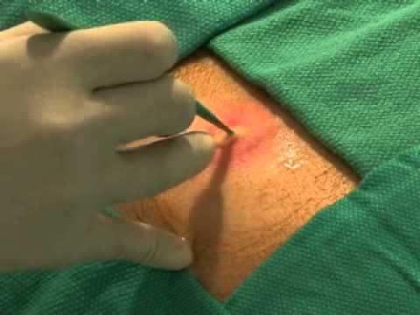
Abscess Incision & Drainage

Slide 2
Notes:
This is a typical abscess where areas of both fluctuance and surrounding induration are appreciated
Source: http://www.midlevelu.com/blog/how-drain-abscess

Slide 3
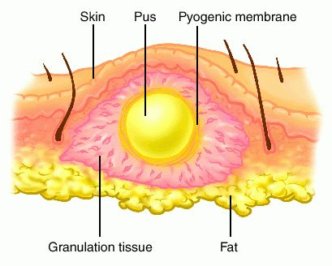
Notes:
The goal of an incision and drainage is to access the underlying pus and allow it to be expressed from the wound
Source: http://medical-dictionary.thefreedictionary.com/

Slide 4
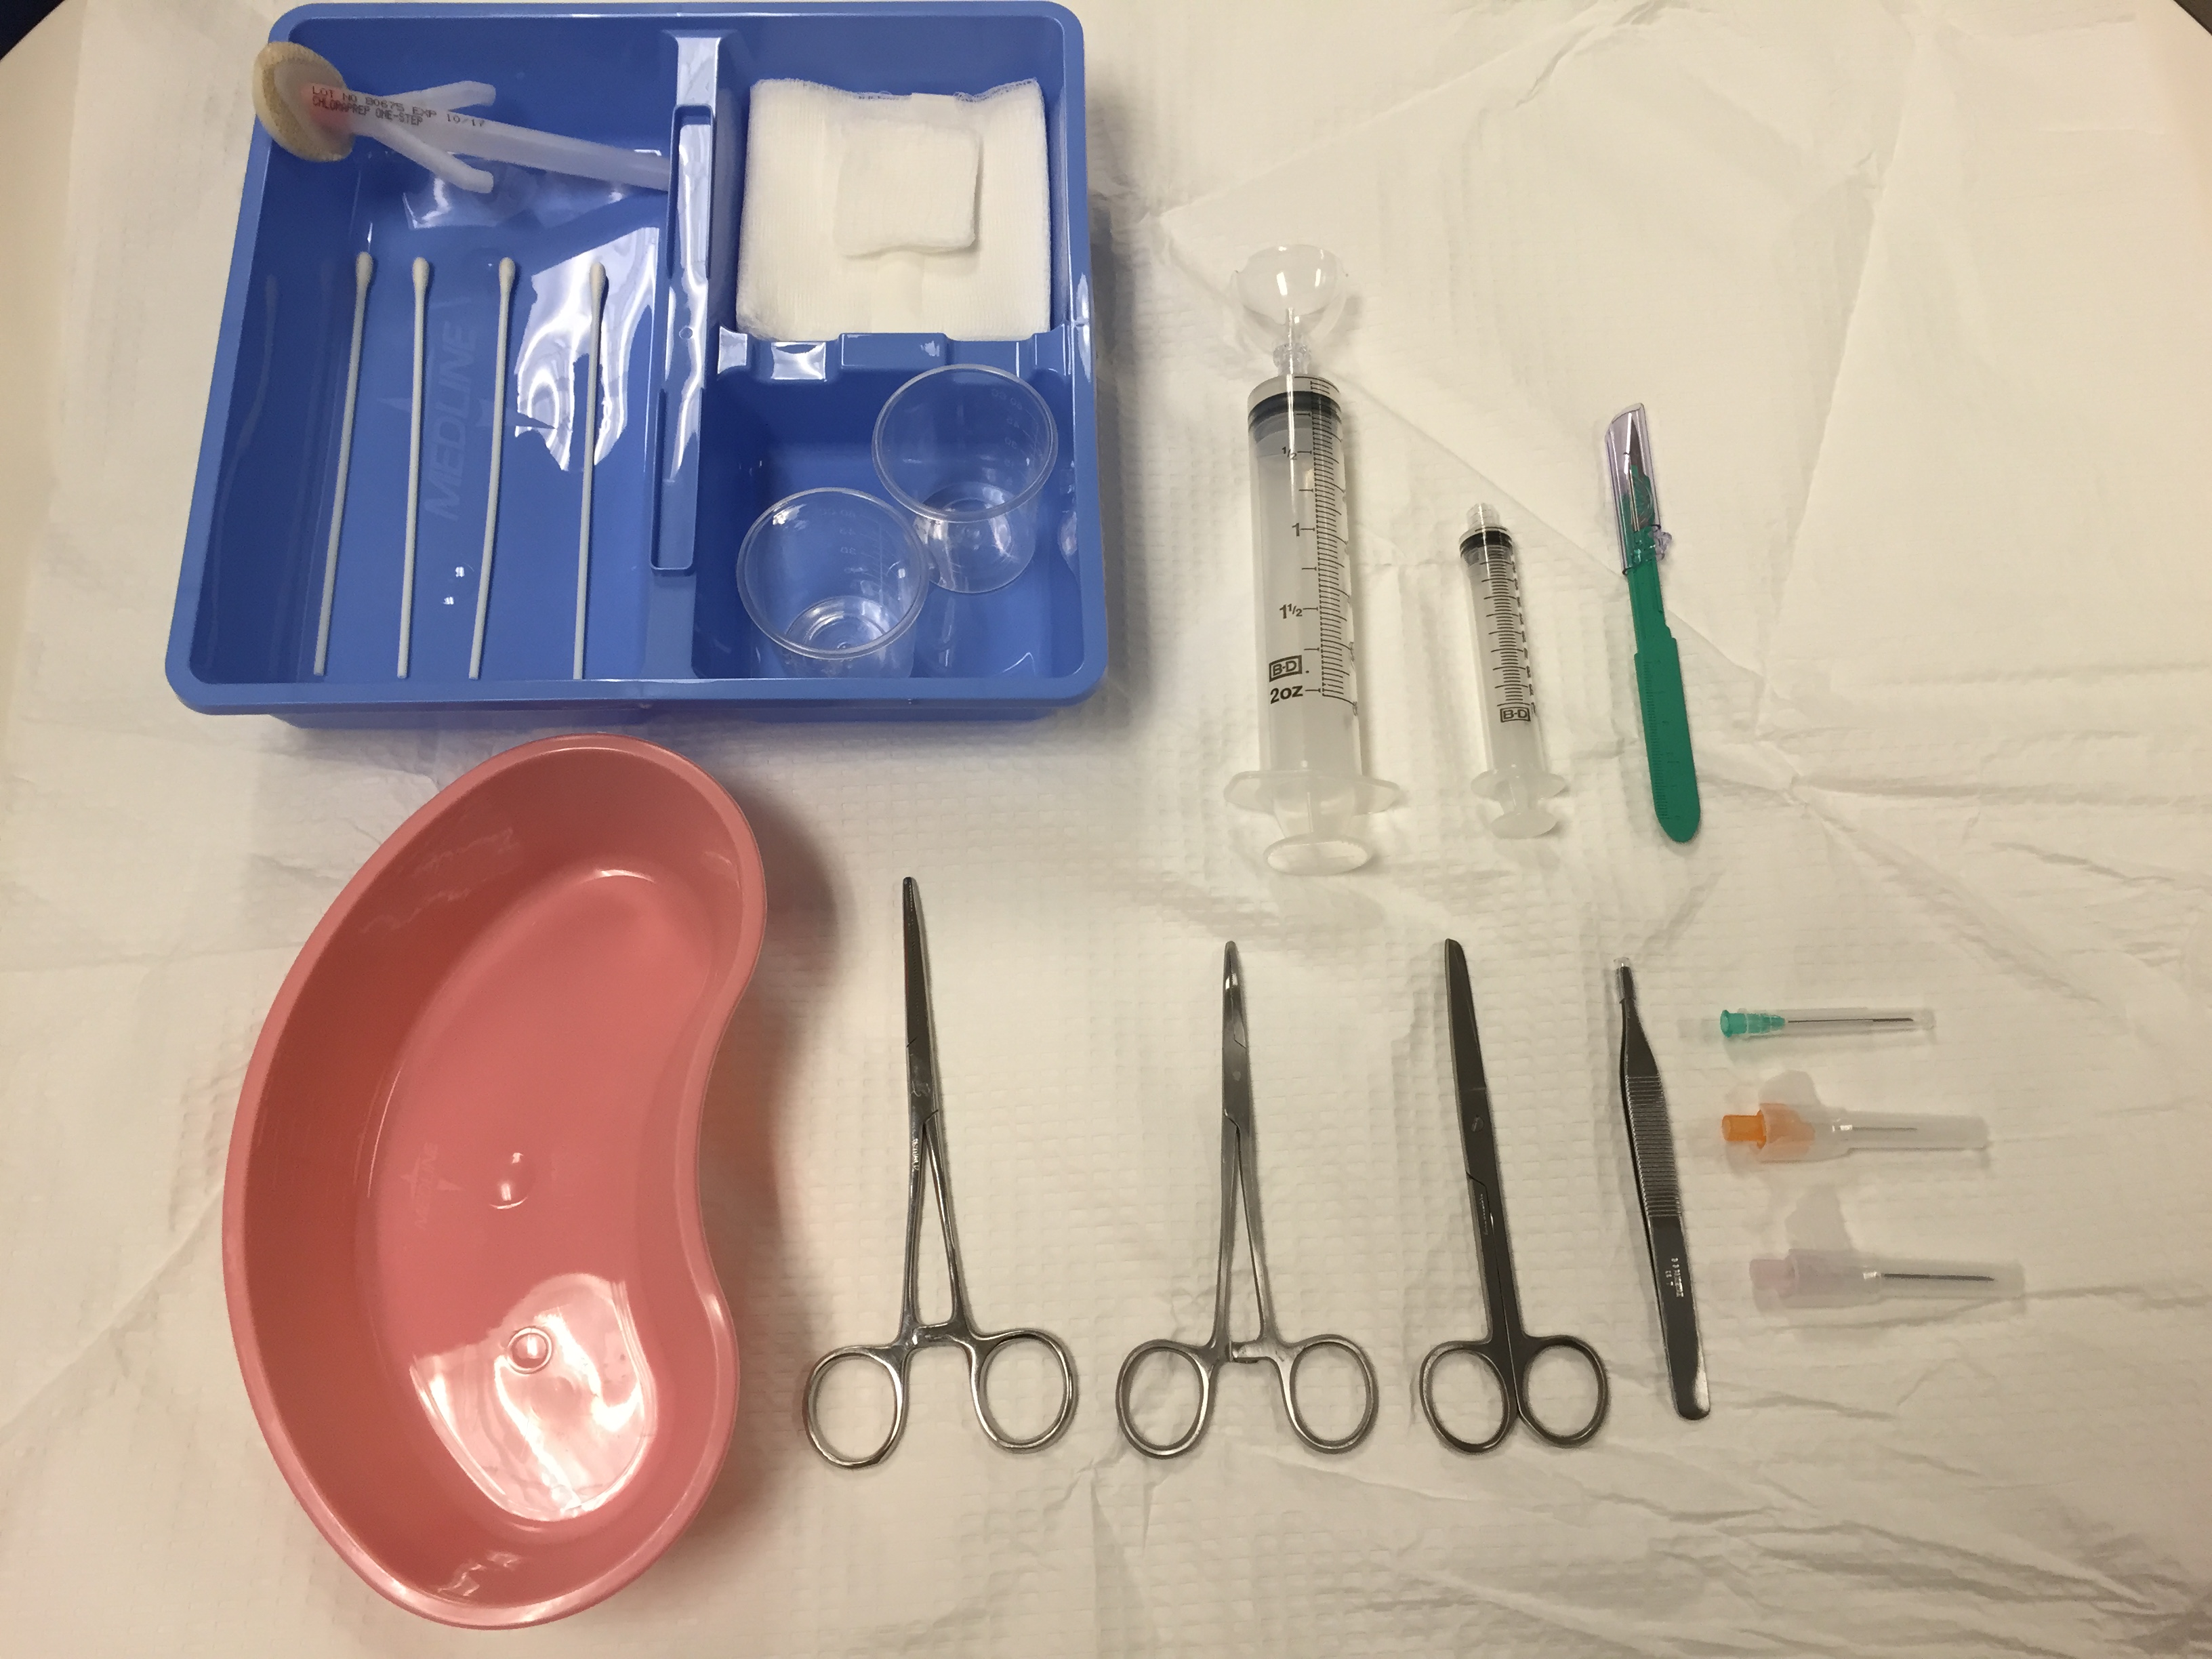
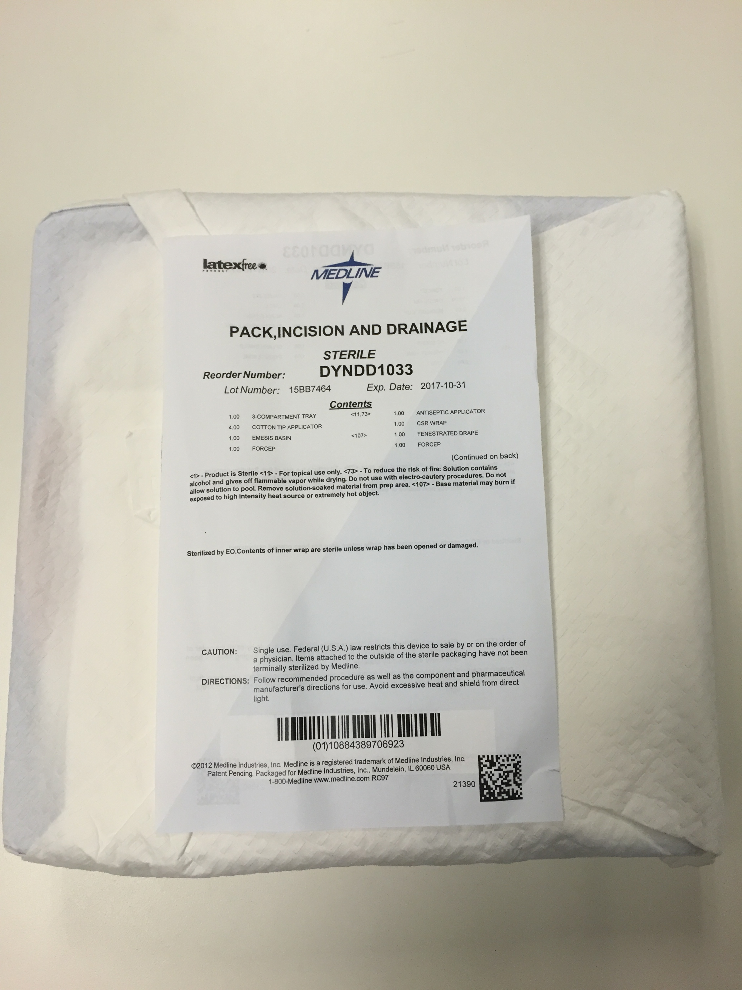
Incision & Drainage Kit
Notes:
These are prepackaged incision and drainage kits
Key instruments include a scalpel to incise the wound and a syringe with a splash guard, or cap, to irrigate the abscess
Notice that the supplies are similar to those in the laceration kits, and can sometimes be used interchangeably
These kits can be found in the clean utility closet of West

Slide 5
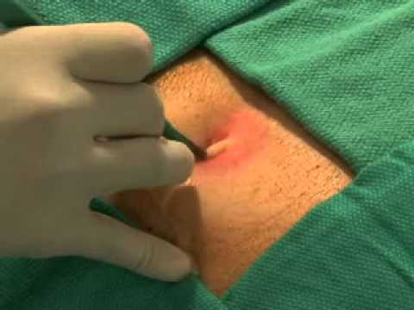
Notes:
After applying local anesthestic, an incision is made in the area of highest fluctuance, followed by copious irrigation to cleanse the abscess of all pus and debris

Slide 6
Lines of Tension
Cutting along natural lines of tension,
also known as Langer Lines, will minimize scarring.

Slide 7
Aftercare Instructions
Some Attendings may advise for placement of packing into the wound after irrigation.
As well, antibiotics may be indicated if there is
sufficient surrounding cellulitis.
Please consult your Attending regarding these
2 issues.
Patients can be referred to our Urgent Care for wound follow-up in 3 days to assess healing.

Slide 8
Video Tutorial
Time Markers
Indications: 0:16
Equipment: 2:28
Prep: 3:37
Anesthesia: 4:16
I&D: 4:53
Packing: 6:52
Aftercare: 7:26
Press Play!
Notes:
Source: https://www.youtube.com/watch?v=XX8v_Rl-O5w

