Slide 1
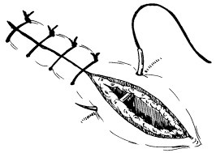
Laceration Repair

Slide 2
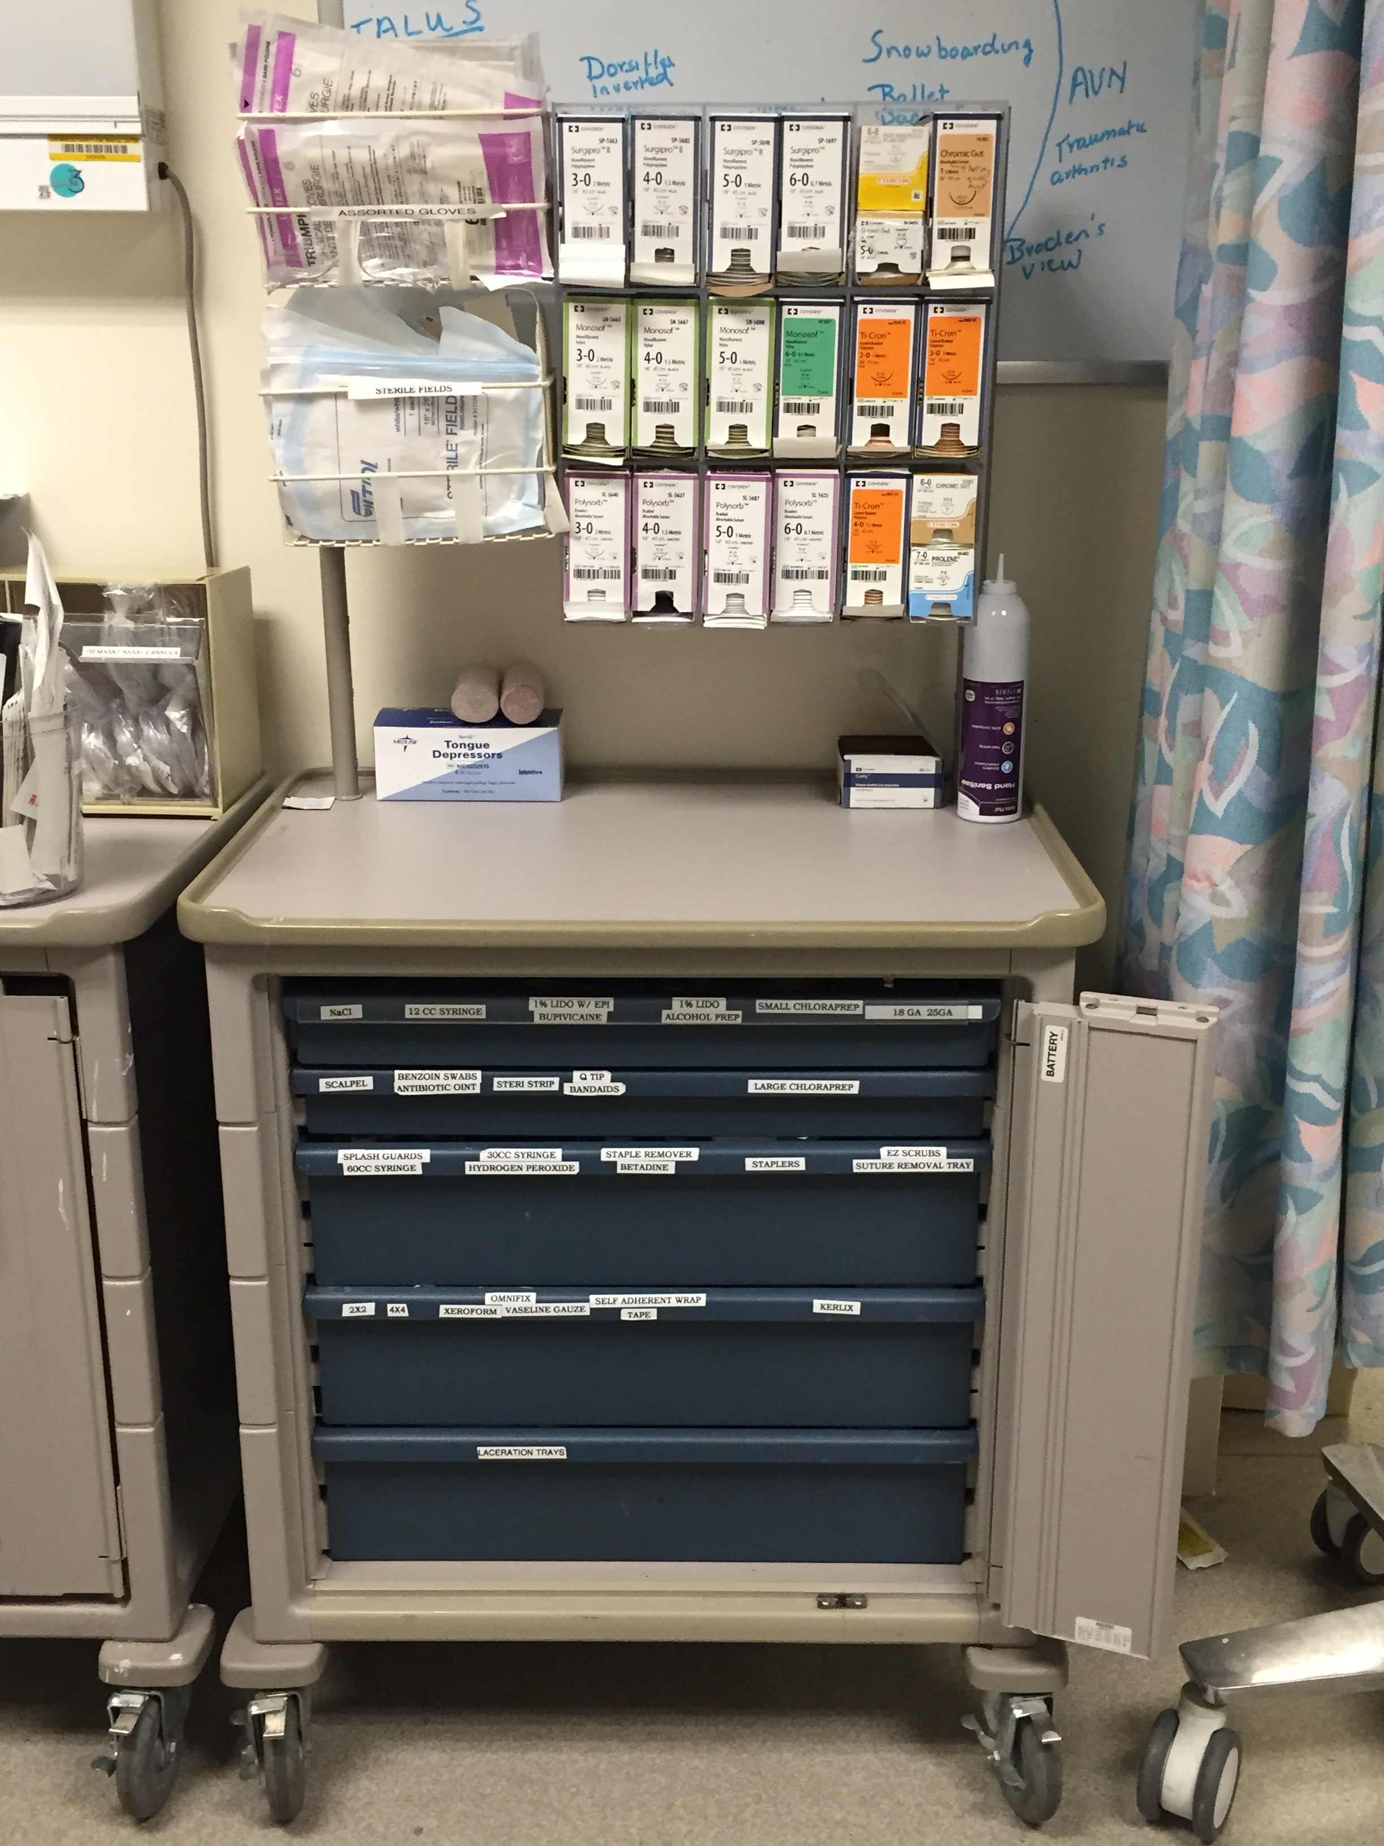
Sterile Gloves
Sutures
Lidocaine, needles, syringes
and the Suture Kits
Code for door
12345#
Notes:
This is the suture cart available in multiple areas of the ER
It has many of the supplies necessary to perform a laceration repair

Slide 3
Steps to Laceration Repair
Local Anesthesia
Inject either Lidocaine or Lidocaine with Epinephrine in and around the wound for anesthesia
Irrigation
Irrigate the wound with copious saline under high pressure and remove any foreign bodies
Suturing
Place sutures to approximate skin edges and ultimately close the wound

Slide 4
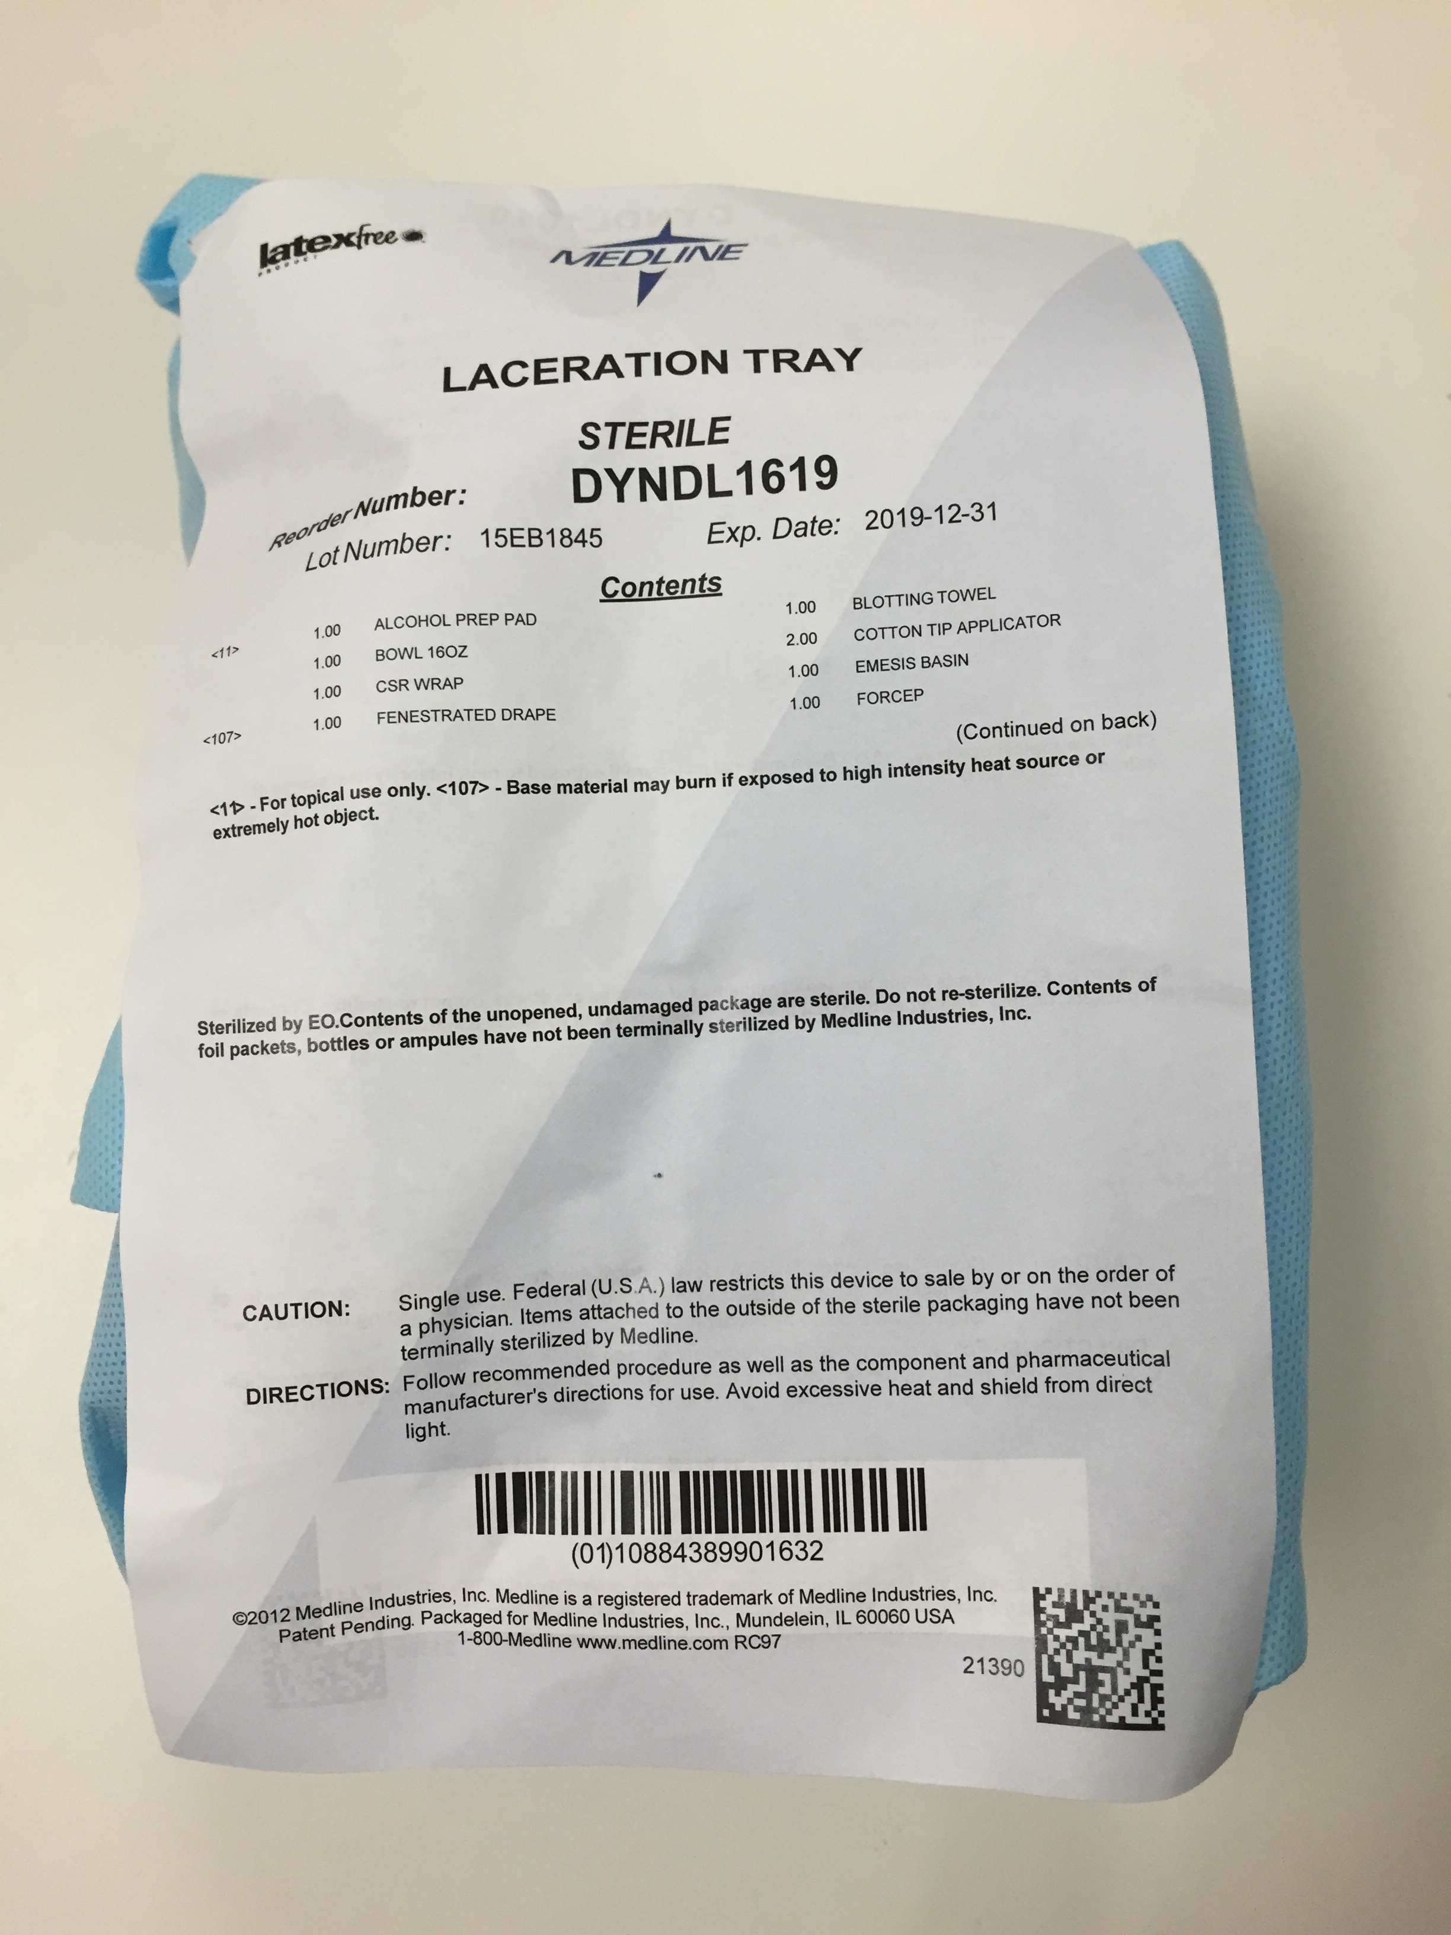
Laceration Kit
Notes:
These are pre-packaged laceration kits. They are located on the bottom drawer of the suture cart or in the clean utility closet.
They contain sheets to create a sterile field, irrigation supplies, needles and syringes to apply local anesthetic, and a needle-driver.
Not pictured, are saline bottles used for irrigation. They can be acquired separately from the clean utility closet.

Slide 5
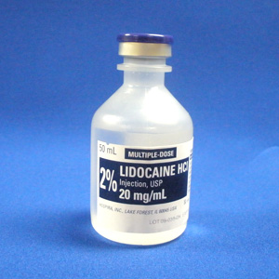
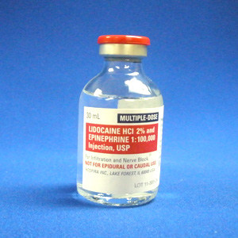
Anesthesia
Lidocaine
Lidocaine with Epinephrine
Relative Contraindications
- Fingers - Tip of nose - Penis
Can be used for direct infiltration into the wound or for nerve blocks

Slide 6
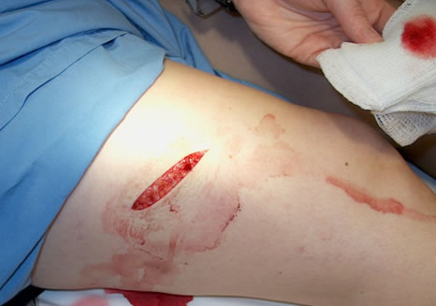
Approach to Repair
Some lacerations may require both deep and superficial repairs
Deep sutures are made with absorbable material
Superficial sutures are made with non-absorbable material
The approach to repair will be decided in 
conjunction with your Attending
Notes:
Pic Source: www.med.uottawa.ca

Slide 7
Suture
• Non-Absorbable
Prolene
Absorbable
Fast Absorbing Surgical Gut (FASG)
Vicryl
• The higher the number, the finer the suture
5-0 and 6-0 for face
3-0 and 4-0 for extremities

Slide 8
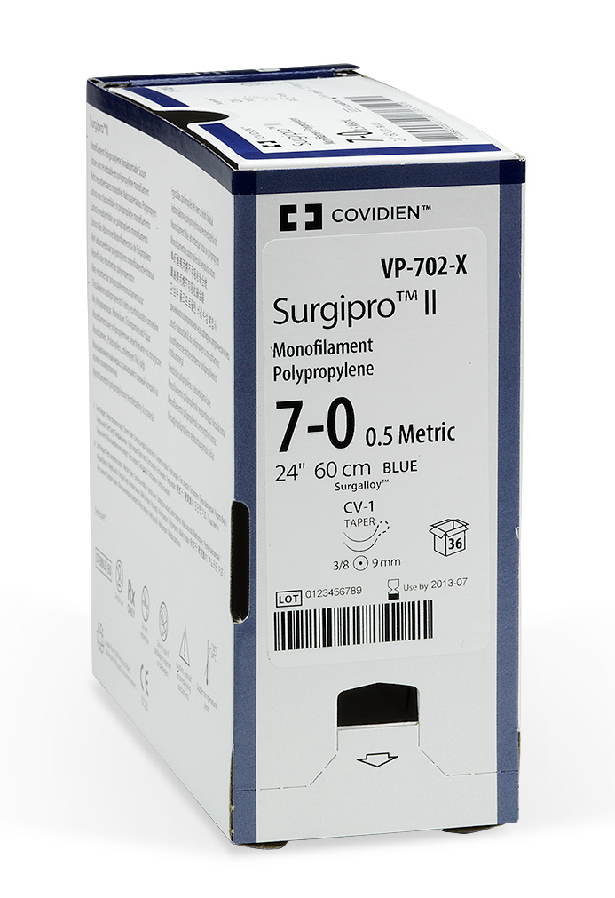
Non-Absorbable Sutures
Prolene aka “Surgipro”

Slide 9
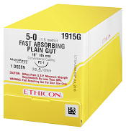
Absorbable Sutures
Fast-Absorbing Surgical Gut
Looses tensile strength in 7 days, fully absorbs in 21-42 days
Can also be used on the face
and mucosa (lips), esp. in children
Vicryl aka “Polysorb”
Looses tensile strength in 14-21 days, fully absorbs in 56-70 days

Slide 10
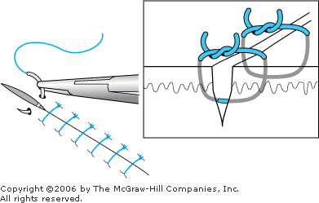
Simple Interrupted Suture
Notes:
Most of your repairs will involve placing what is referred to as simple, interrupted sutures
A diagram depicting this technique is shown.
Source: McGraw-Hill Access Medicine

Slide 11
Simple Interrupted Suture, Video Tutorial
Press Play!
For other helpful videos, please visit the Videos & Links section of the website.
Notes:
Source: https://www.youtube.com/watch?v=VmaenFTww9w

Slide 12
Follow-Up
Sutures on the face should be removed in 3-5 days
Sutures on the torso and extremities should be removed in 7-10 days
Patients can be referred to our Urgent Care for suture removal

