Slide 1
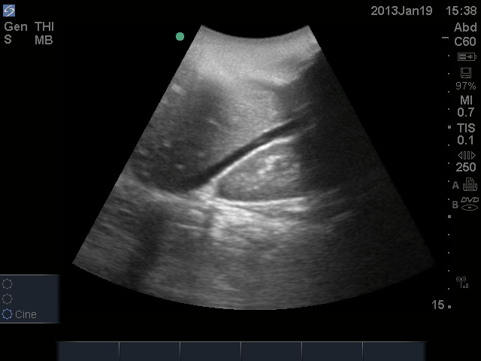
Ultrasound Basics

Slide 2
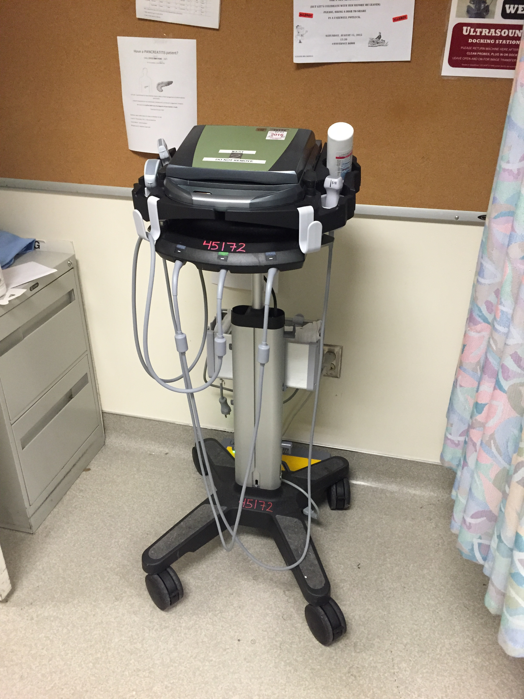

Notes:
The is an ultrasound machine, you will find it docked at designated areas in both North and West

Slide 3
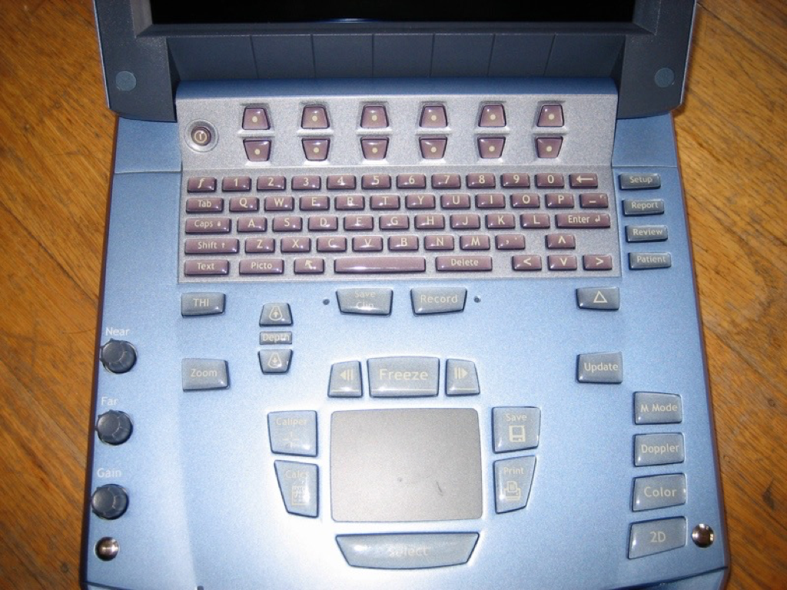
Notes:
This is the keypad of the ultrasound machine

Slide 4
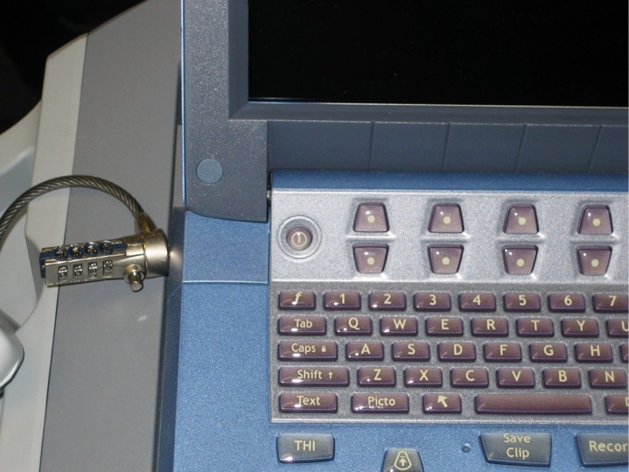
On ->
button
Notes:
This is the on button

Slide 5
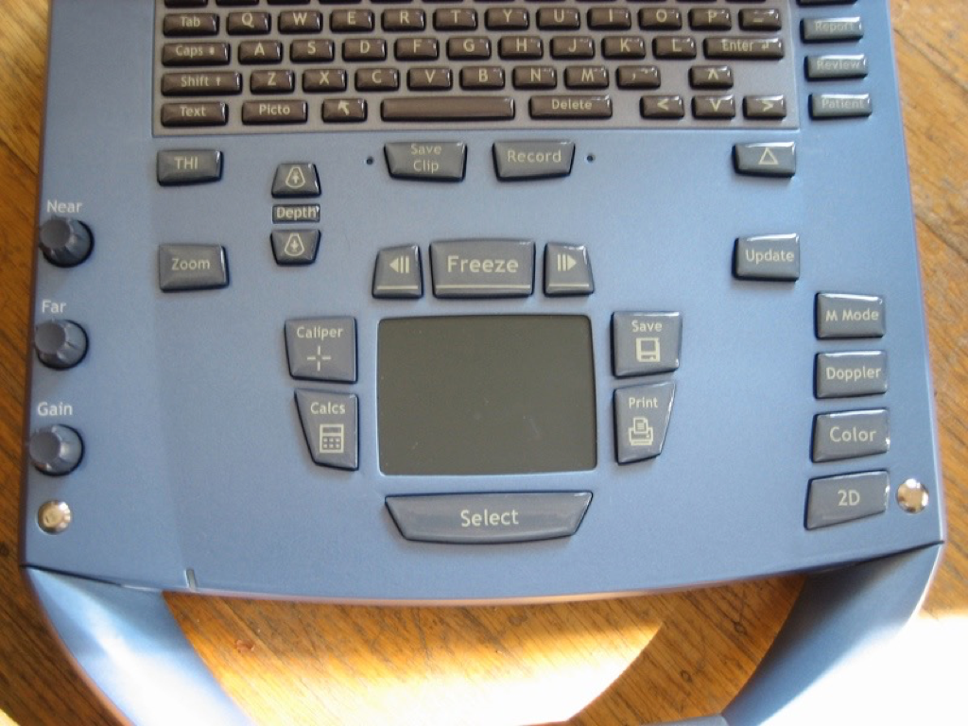
Notes:
These buttons adjust the depth and gain or brightness of your image.

Slide 6
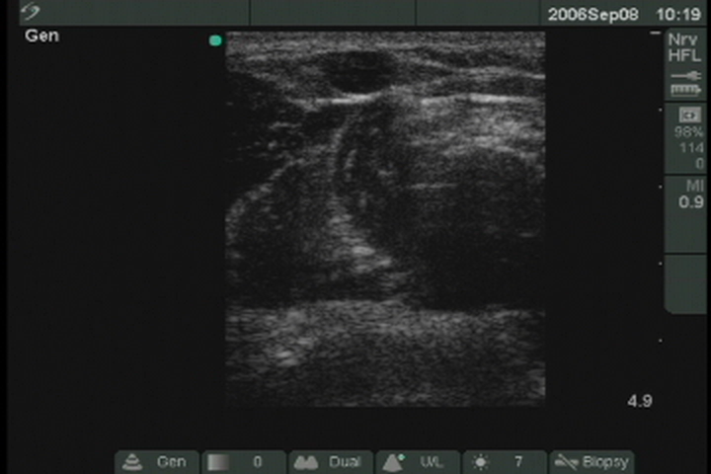
Adjusting the Depth
Press
Play!
Notes:
Notice how when you adjust the depth you are able to focus on superficial versus deeper structures.
Also note on the right-hand portion of the screen, there are centimeter markers to gauge your depth

Slide 7
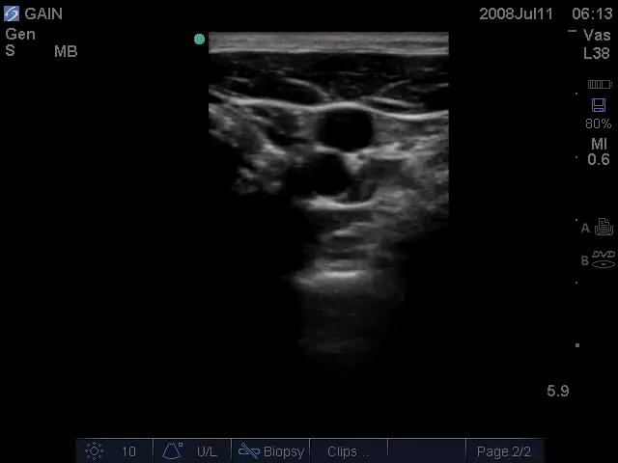
Adjusting the Gain
Press
Play!
Notes:
Notice how adjusting your gain increases the brightness of your image

Slide 8
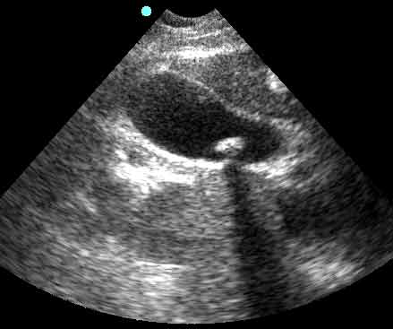
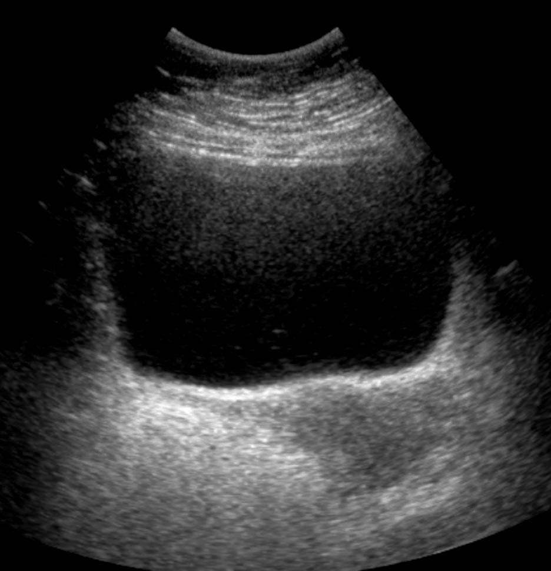
Image Generation
⬥ More dense objects
(e.g. bone or a stone)
show up as “brighter”
or hyperechoic.
Gallbladder
Stone
⬥ Less dense objects
(e.g. urine or blood) show up as “darker”
or anechoic.
Bladder
Urine

Slide 9
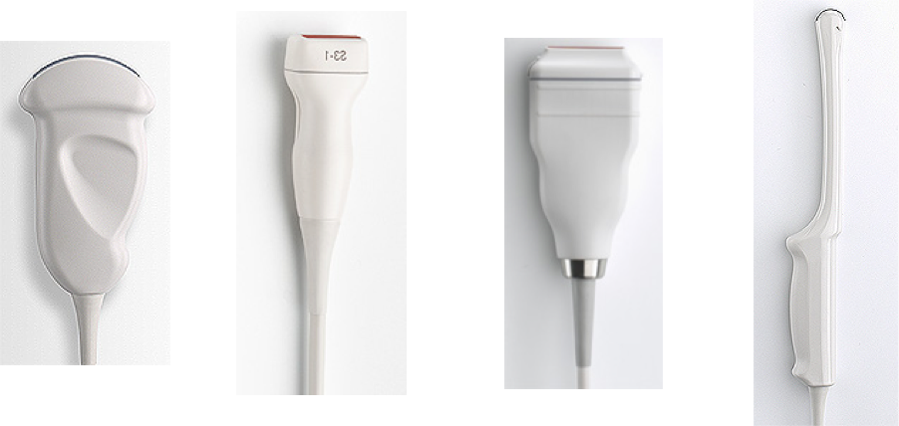
Different Probes
Lower Frequency Probes
Higher Frequency Probes
Torso and abdomen
Skin surface
Endocavitary, e.g. intravaginal

Slide 10
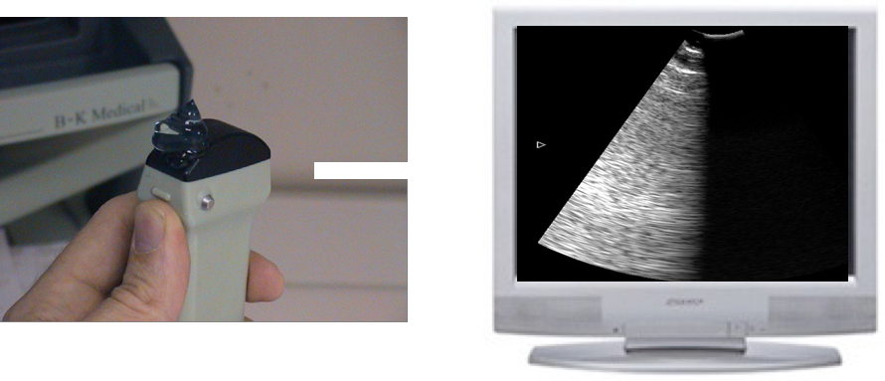
The directional indicator or
“probe marker” corresponds to the left side of the screen

Slide 11
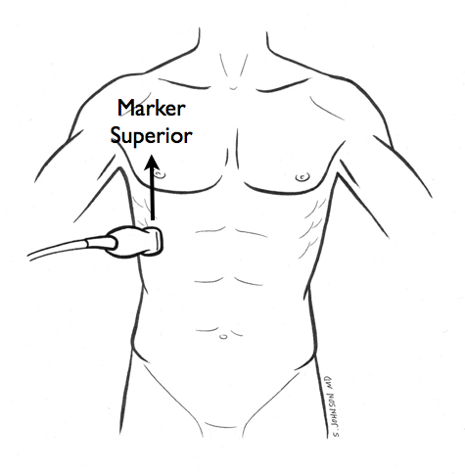
The probe marker should always point towards the patient’s head or right side.

Slide 13
Common ED Uses for Ultrasound
Examine the kidneys for hydronephrosis or a calculus
Examine the heart for a pericardial effusion and a gross estimation of ejection fraction
Examine the bladder for distention or a calculus
Check for free fluid in the abdomen and/or pelvis (aka the FAST exam)

Slide 14
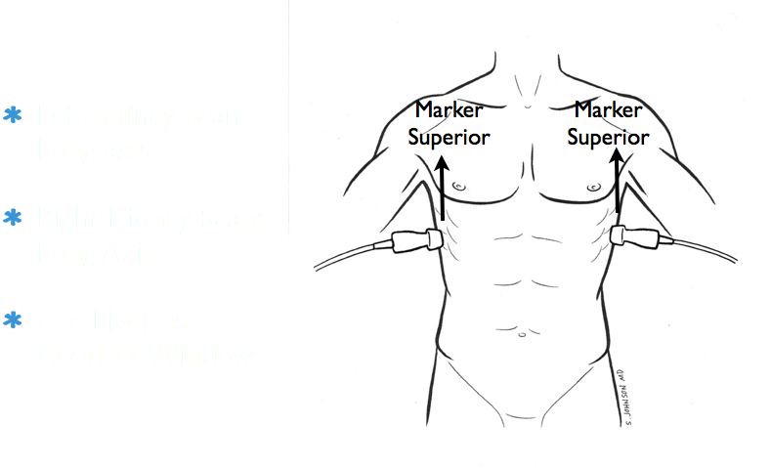
Renal Exam

Slide 15
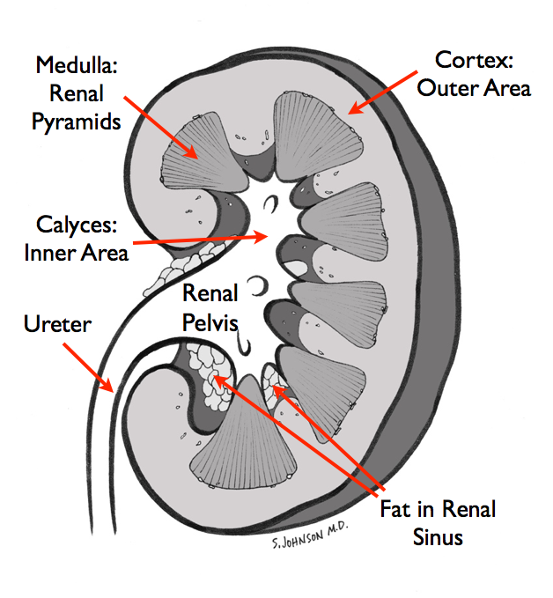
Renal Exam, cont.
Renal
Anatomy

Slide 16
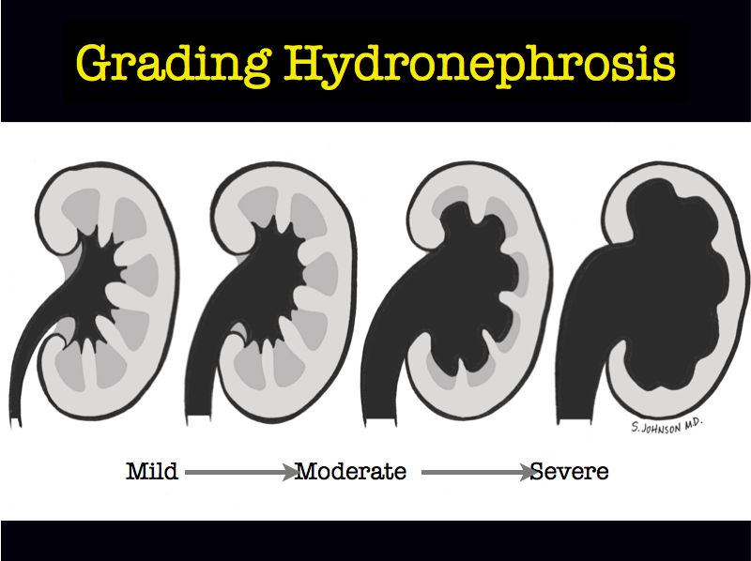
Renal Exam, cont.

Slide 17
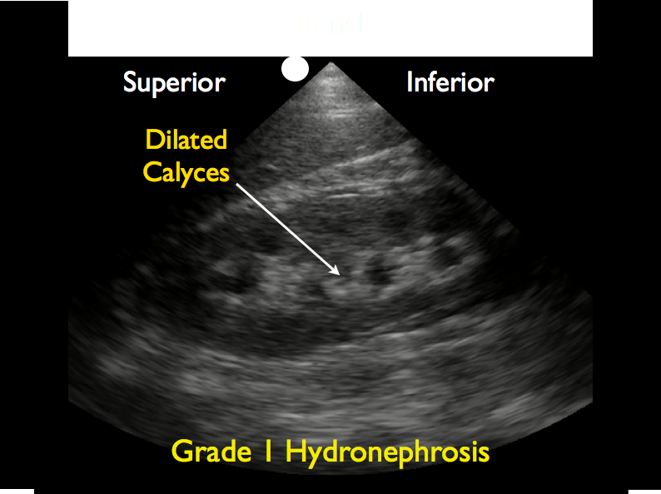

Slide 18
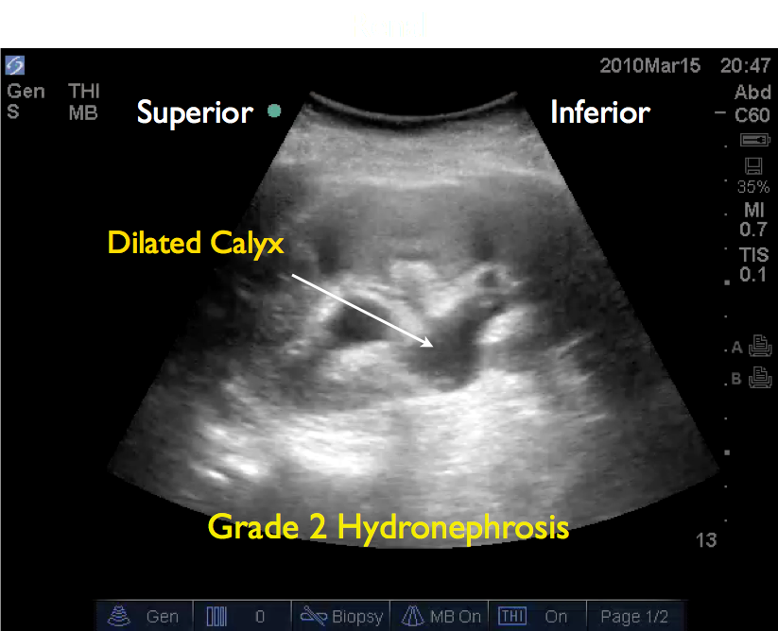

Slide 19
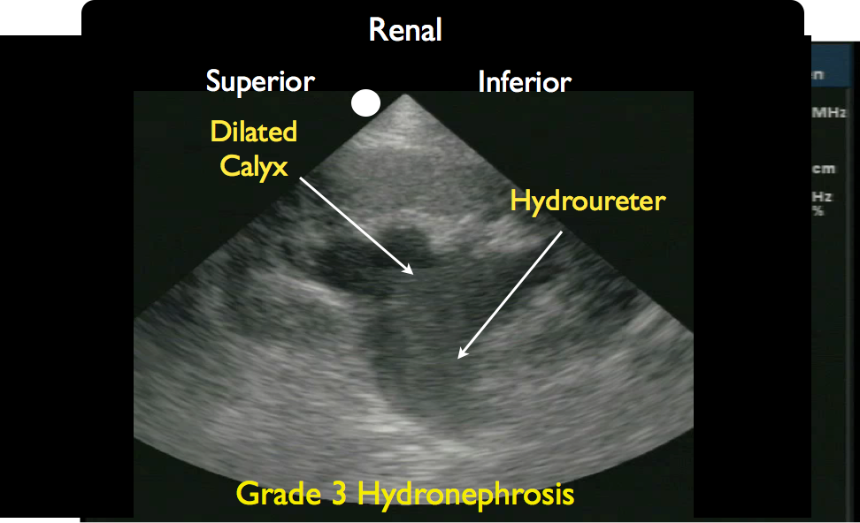

Slide 20
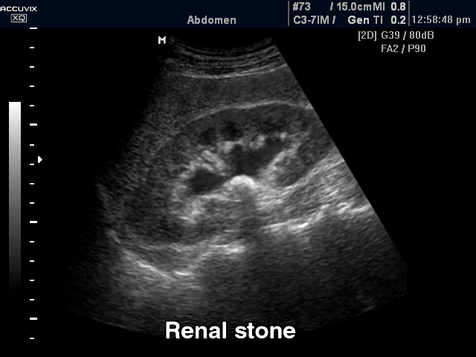
Renal Exam, cont.
Renal Calculus with Hydronephrosis
Hydronephrosis
Stone
Note the shadow cast by the stone

Slide 21
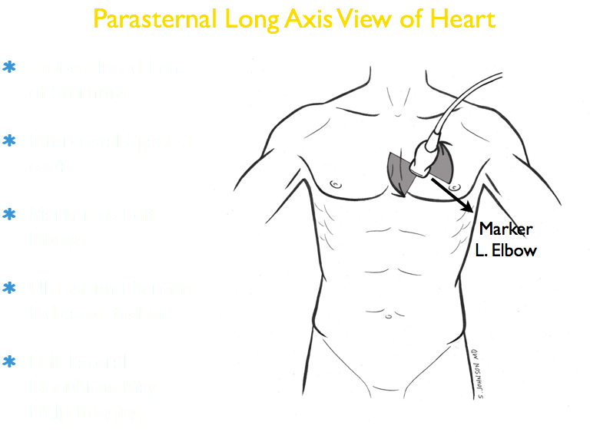
Cardiac Exam

Slide 22
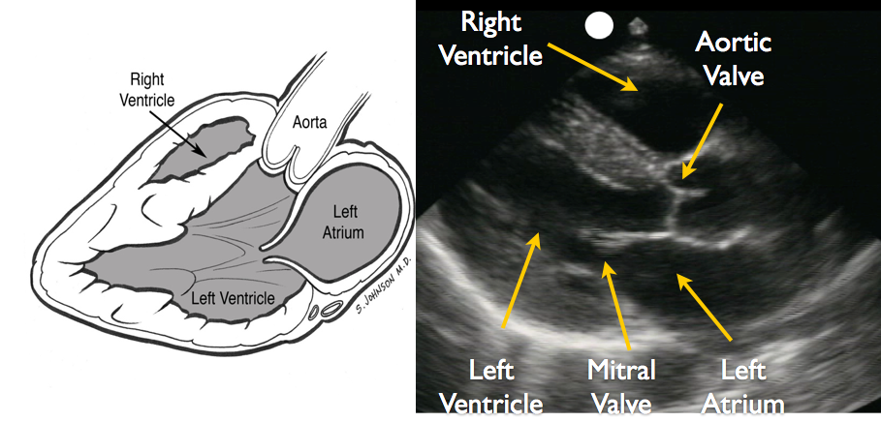
Cardiac Exam, cont.
Parasternal Long Axis View

Slide 23
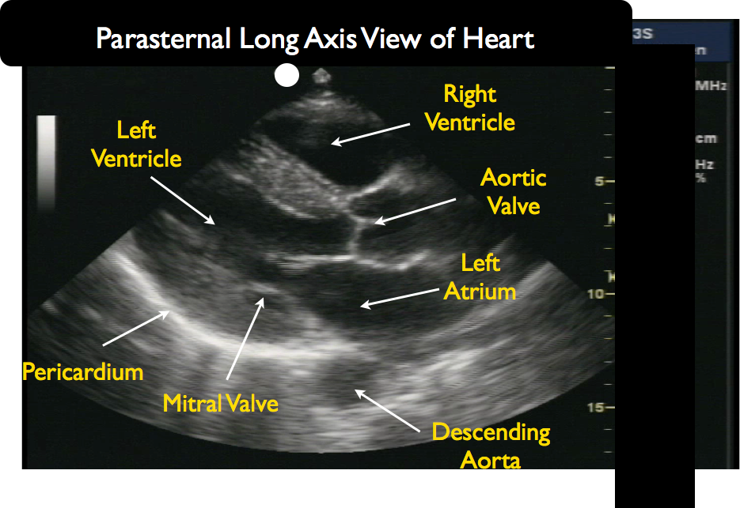
Cardiac Exam, cont.
*Note the solid white line

Slide 24
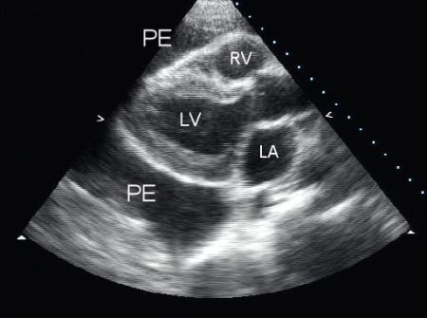
Cardiac Exam, cont.
Pericardial Effusion
Pericardial Effusion
*The white line is now split, indicating fluid in the pericardial sac

Slide 25
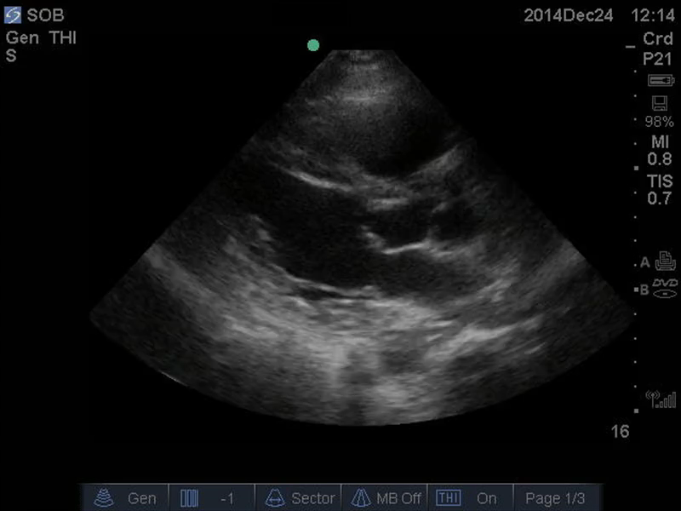
Cardiac Exam, cont.
Estimating Ejection Fraction: Normal
Notice, the strong
“squeeze” of the
left ventricle.
LV
Press
Play!

Slide 26
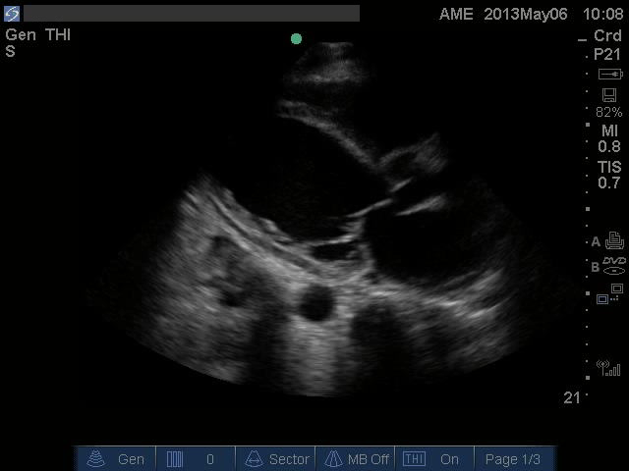
Cardiac Exam, cont.
Estimating Ejection Fraction: Reduced
Notice, the poor “squeeze” of the
left ventricle.
LV
Press
Play!

Slide 27
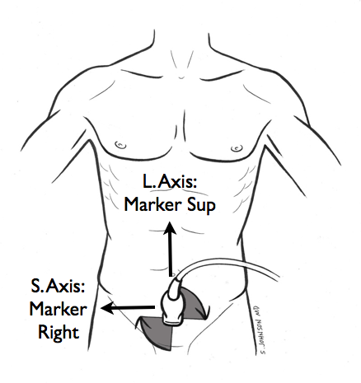
Bladder Exam
Short Axis: Probe marker towards the patient’s right
Long Axis: Probe marker towards the patient’s head

Slide 28
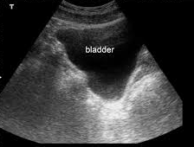
Bladder Exam, cont.
Short Axis
Probe marker towards the patient’s right
Long Axis
Probe marker towards the patient’s head
Bladder
Bladder

Slide 29
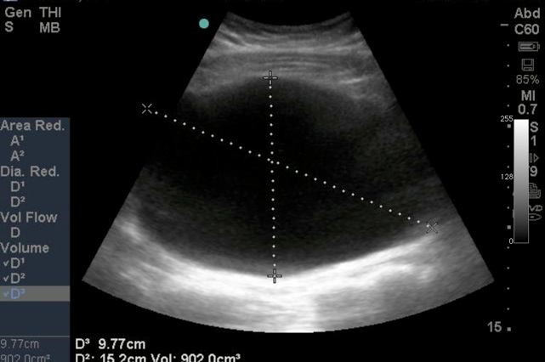
Bladder Exam, cont.
Bladder Distension
*Your Attending or
a senior resident
will assist you with
taking measurements
to check for an
increased post-void
residual (PVR).

Slide 30
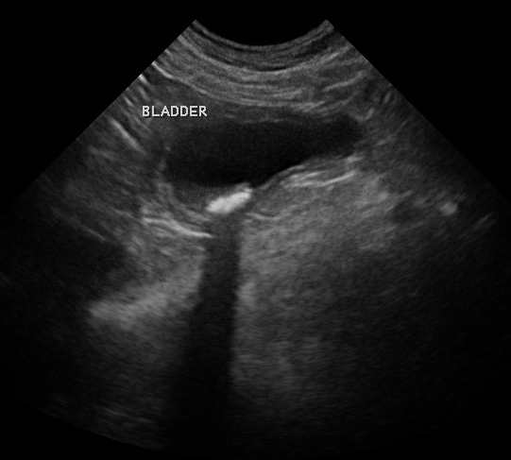
Bladder Exam, cont.
Bladder Calculus
Stone
Note the shadow cast by the stone

Slide 31
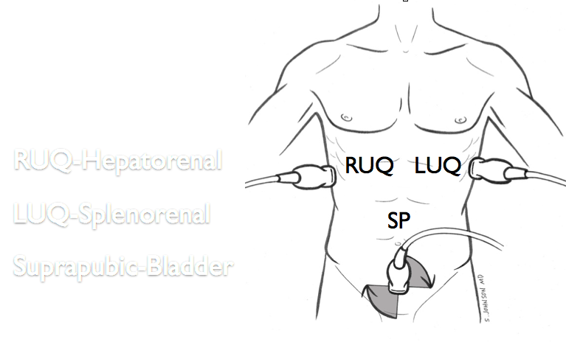
Free Fluid Check aka FAST Exam
3 Views

Slide 32
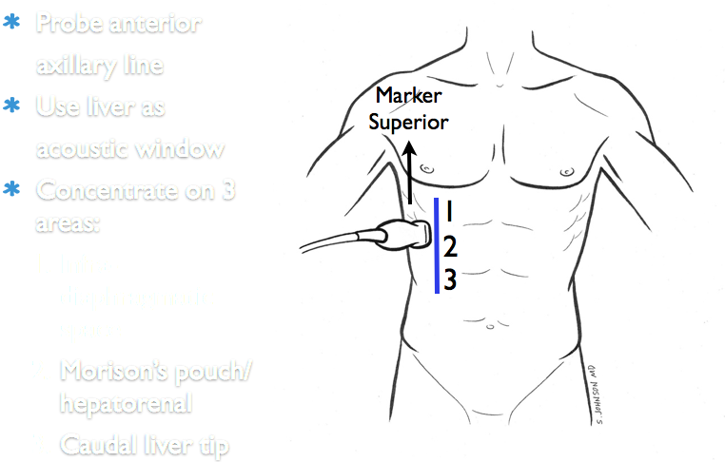
FAST Exam, cont.
RUQ View

Slide 33
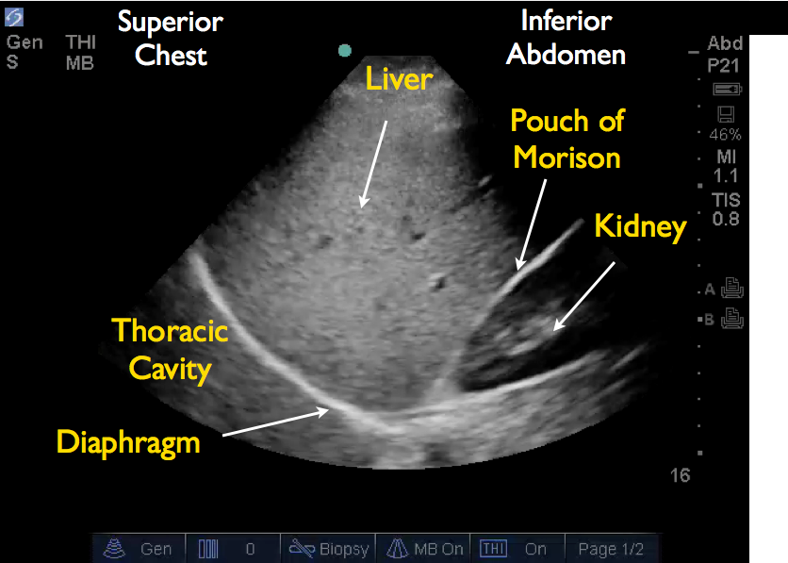
FAST Exam, cont.
RUQ View NORMAL

Slide 34
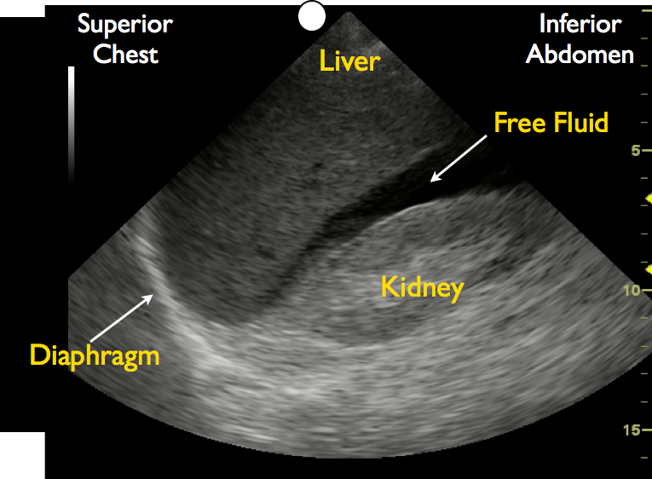
FAST Exam, cont.
RUQ View ABNORMAL, +Free Fluid

Slide 35
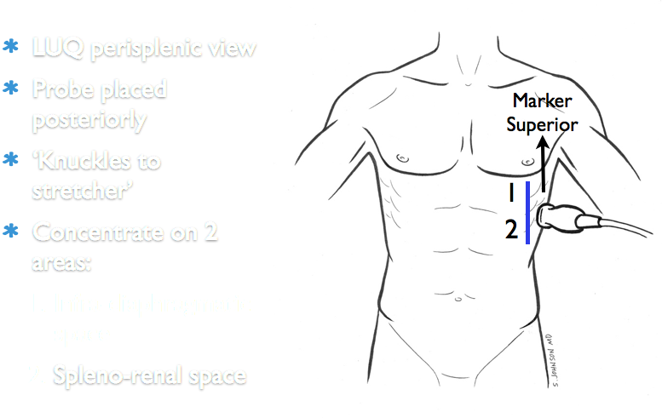
FAST Exam, cont.
LUQ View

Slide 36
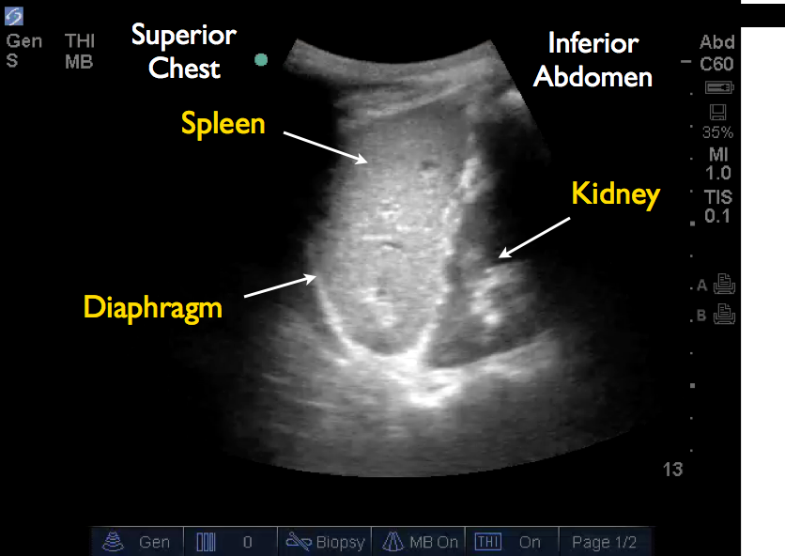
FAST Exam, cont.
LUQ View NORMAL

Slide 37
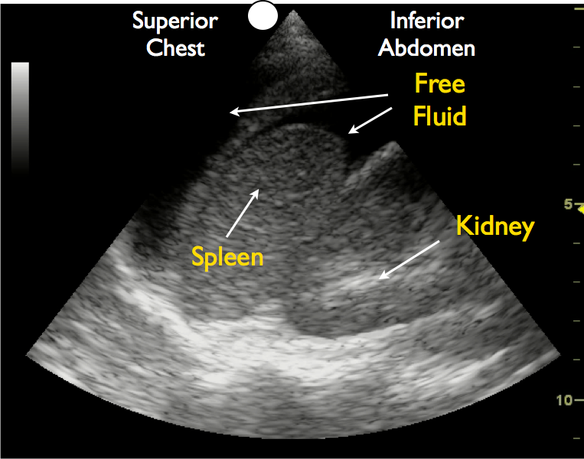
FAST Exam, cont.
LUQ View ABNORMAL, +Free Fluid

Slide 38
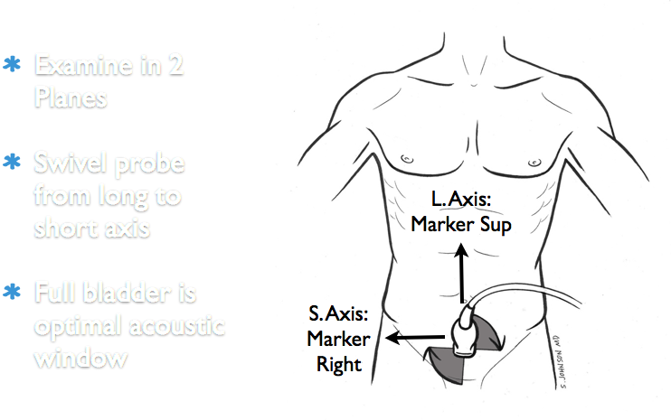
FAST Exam, cont.
Suprapubic View

Slide 39
FAST Exam, cont.
Suprapubic View NORMAL
Short Axis
Long Axis
Bladder
Bladder

Slide 40
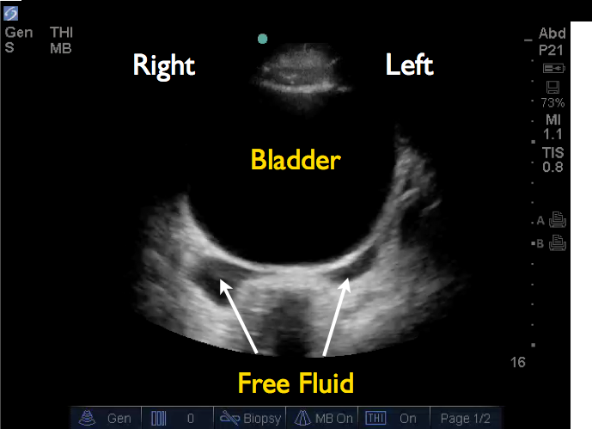
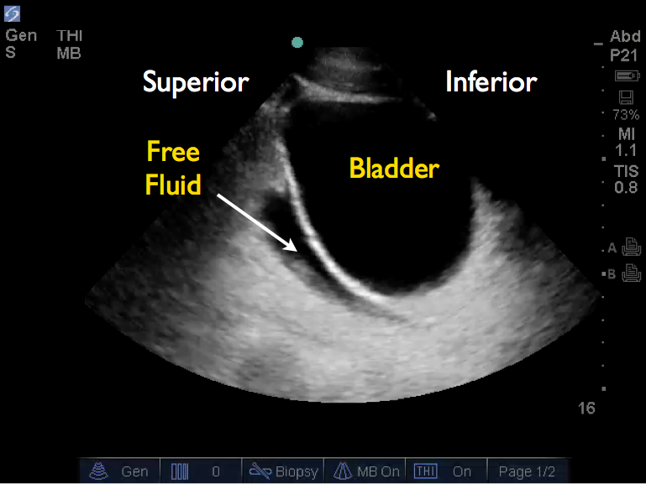
FAST Exam, cont.
Suprapubic View ABNORMAL, +Free Fluid
Short Axis
Long Axis

Slide 41
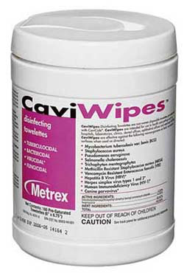
After Your Exam…
Please make sure to wipe the probe with the Cavi-Wipes available throughout the ED.
Please return the US machine to its docking station for it to charge.

Slide 42
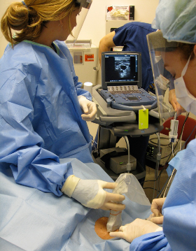
Have fun!

