Slide 1



Welcome to the
Department of Emergency Medicine!
Notes:
Welcome to the Department of Emergency Medicine, the following will help guide you during your rotation

Slide 2
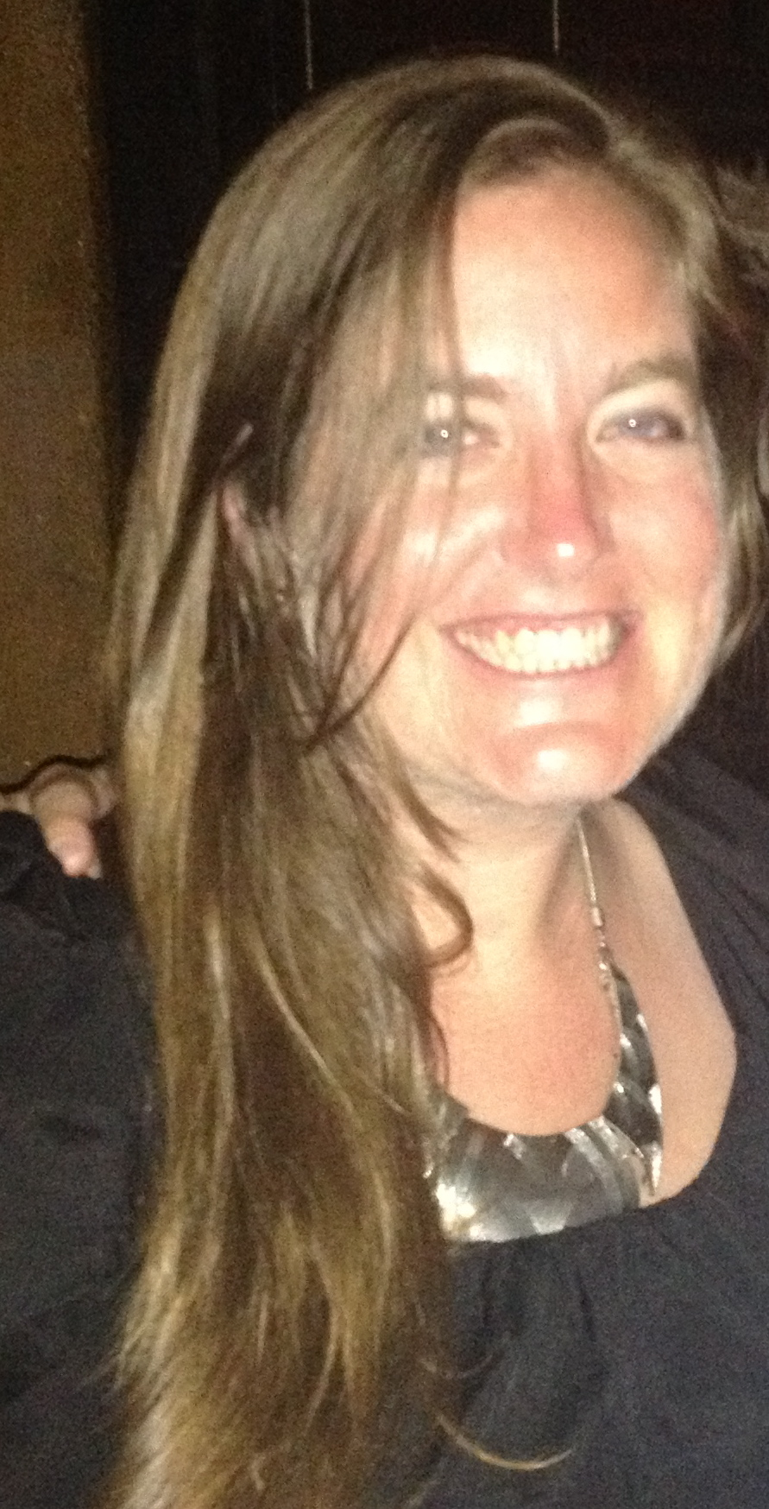
Resources
Dr. Jessica Osterman
General Hospital 1060 Room E jlo114@gmail.com
Notes:
Dr. Jessica Osterman is here to assist you if you have any questions

Slide 3
Schedule
All shifts are 12 hours
  7a shift is from 7am-7pm
  10a shift is from 10am-10pm
  7p shift is from 7pm-7am
"W" is our West area
"N" is our North area
Please contact Dr. Jessica Osterman with any schedule requests for exams or high priority engagements, such as weddings. Personal days should be traded between rotators.

Slide 4
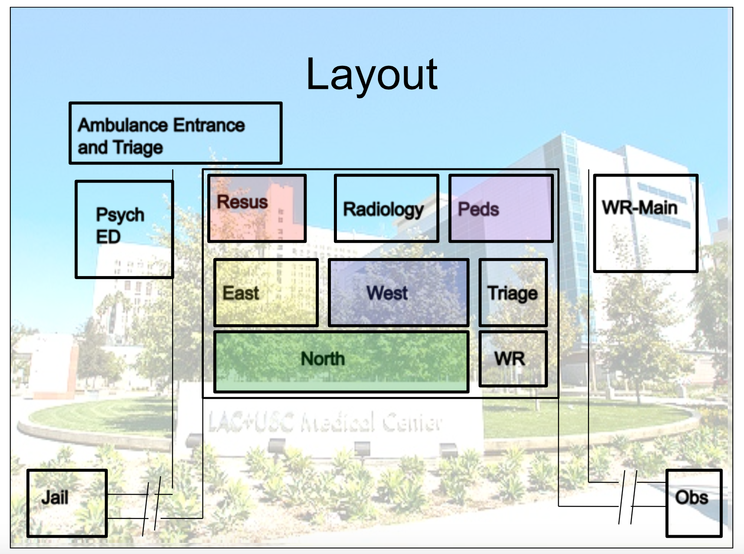
Notes:
Our department is separated into multiple areas
You will be rotating primarily in West and North

Slide 5
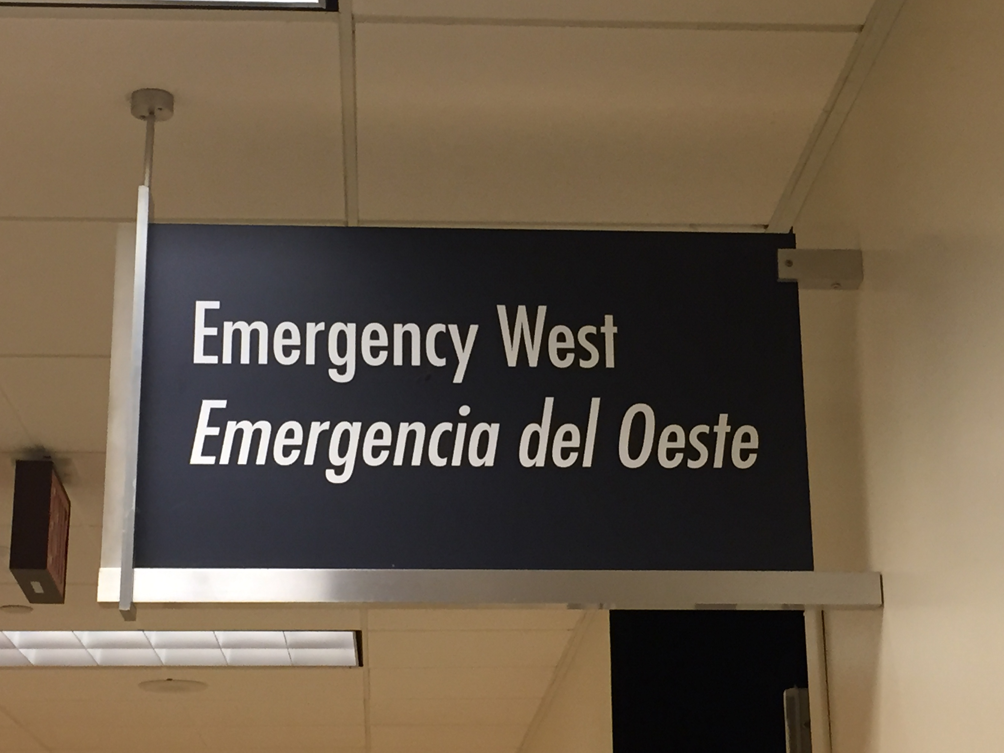
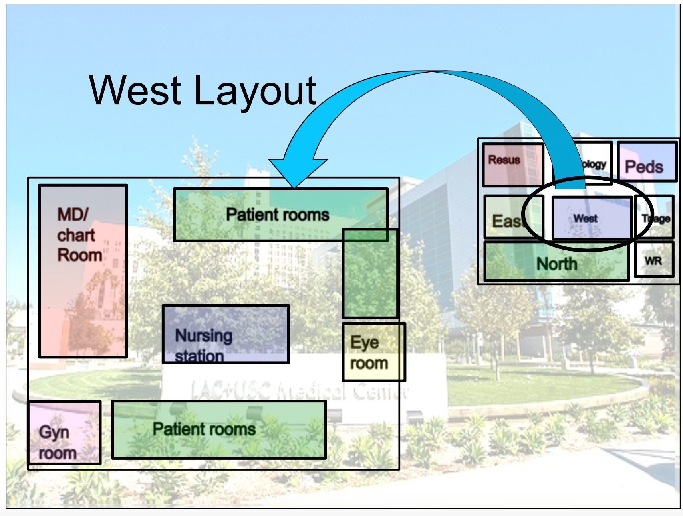
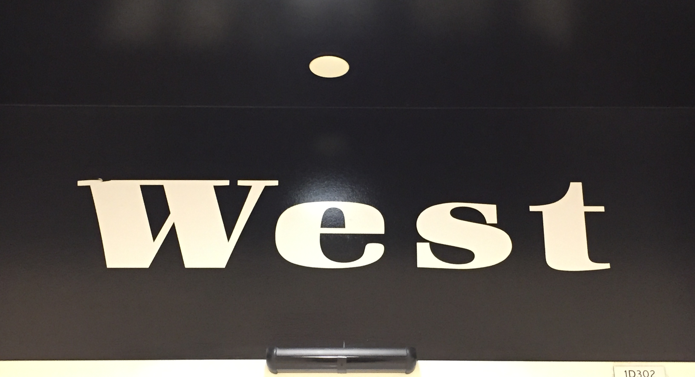
Notes:
West generally sees “fast track patients” and will include Minor trauma, Ocular & ENT complaints, Vaginal bleeding, and First trimester abdominal pain
This is a general layout of West

Slide 6
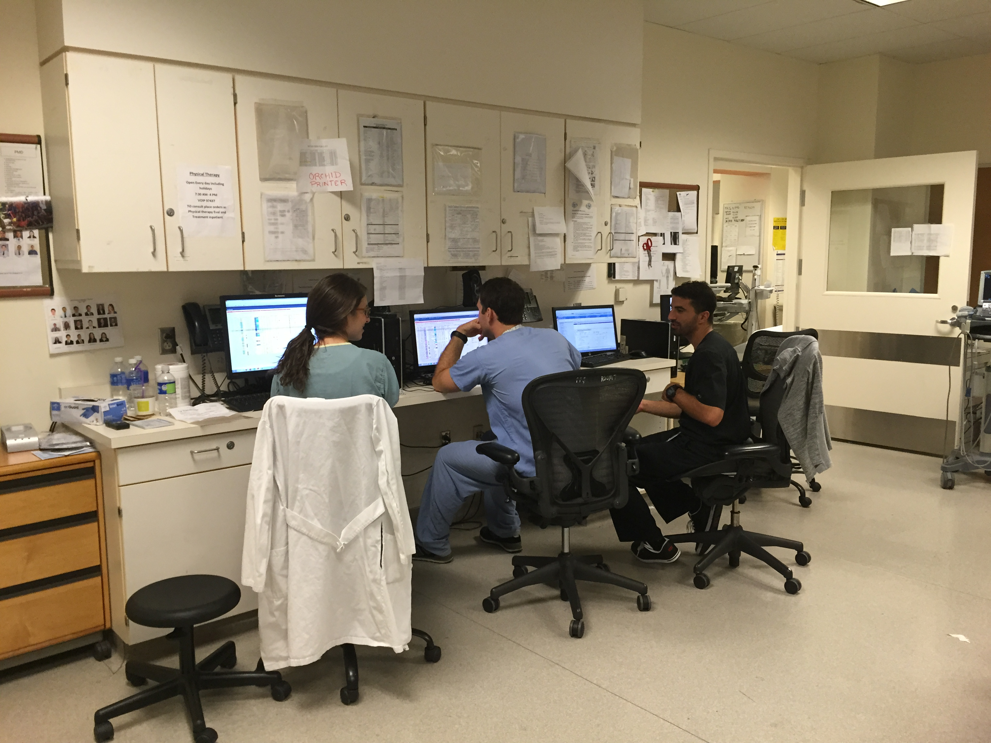
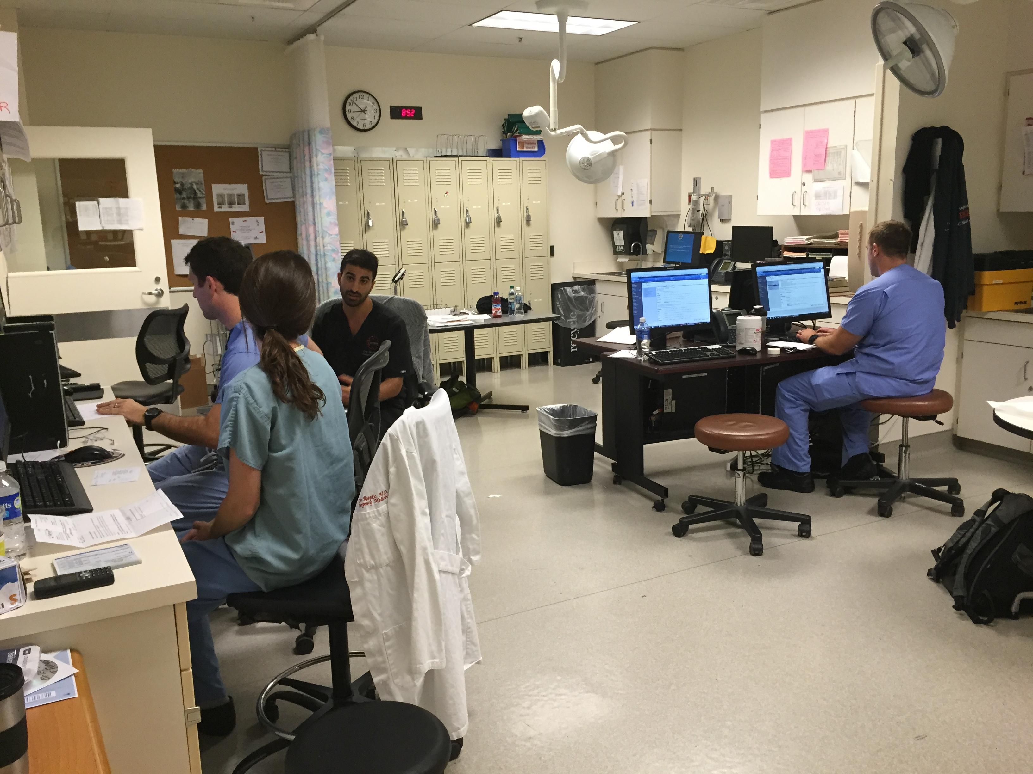
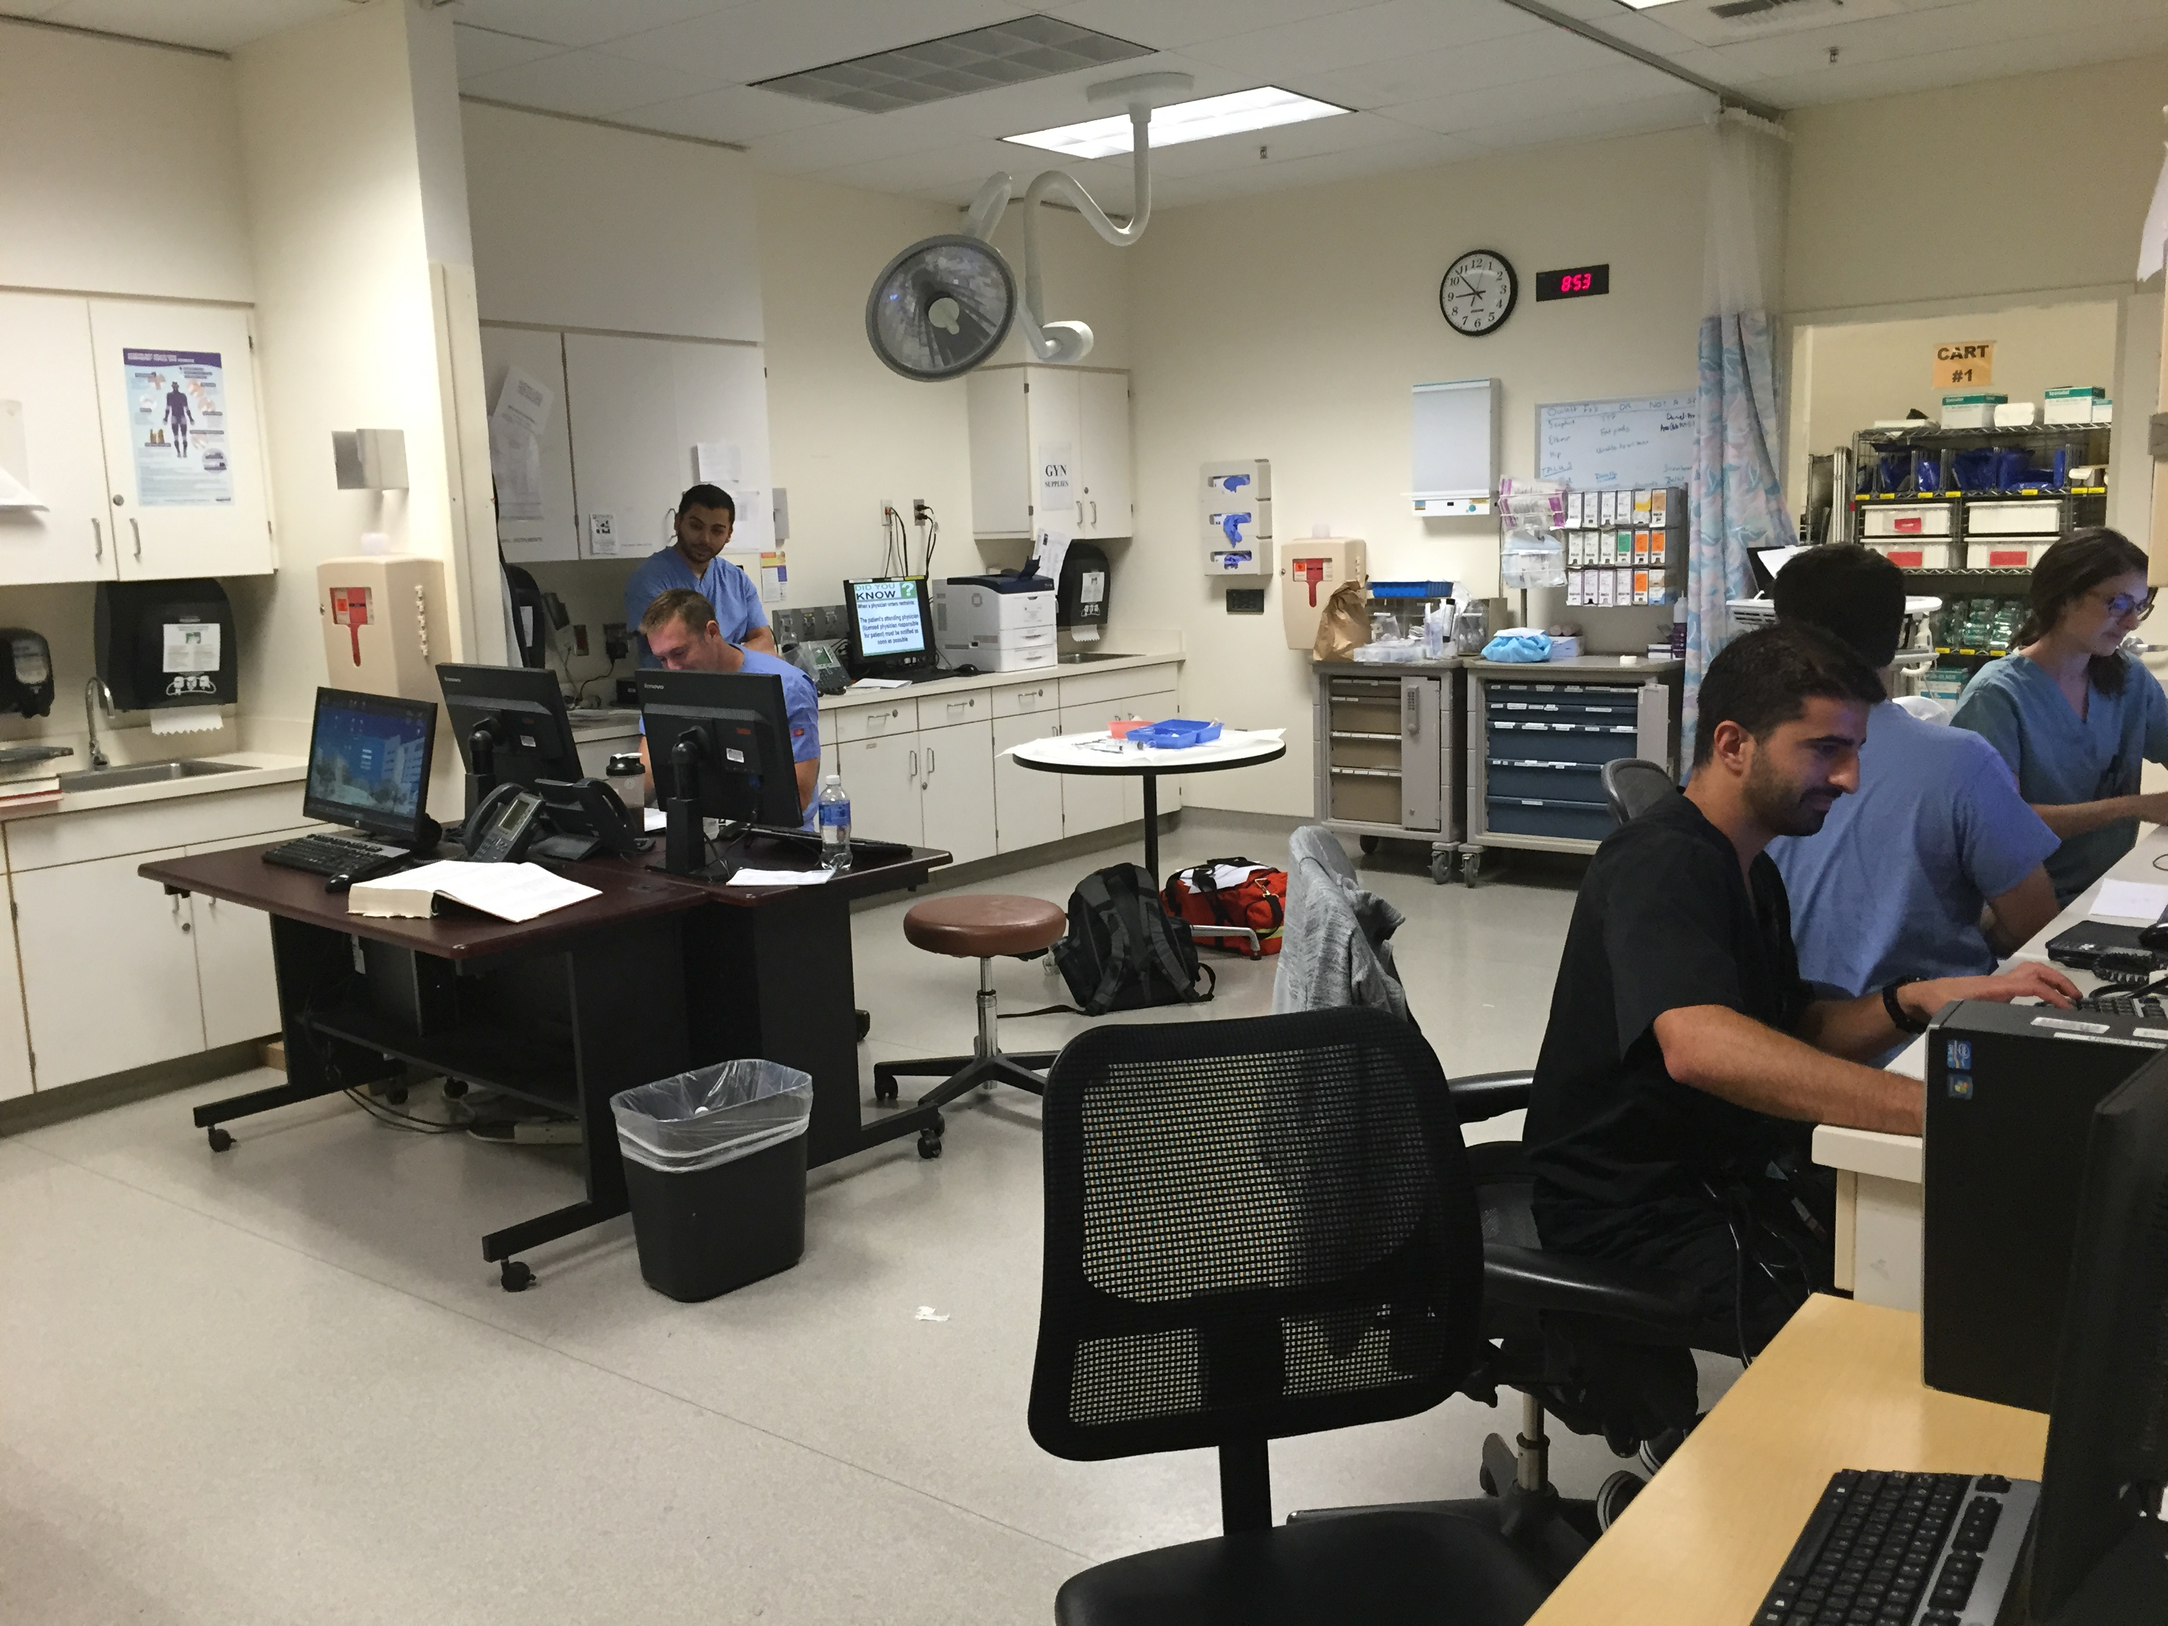
Notes:
This is the West doctors work room, where you will discuss cases and perform your charting

Slide 7
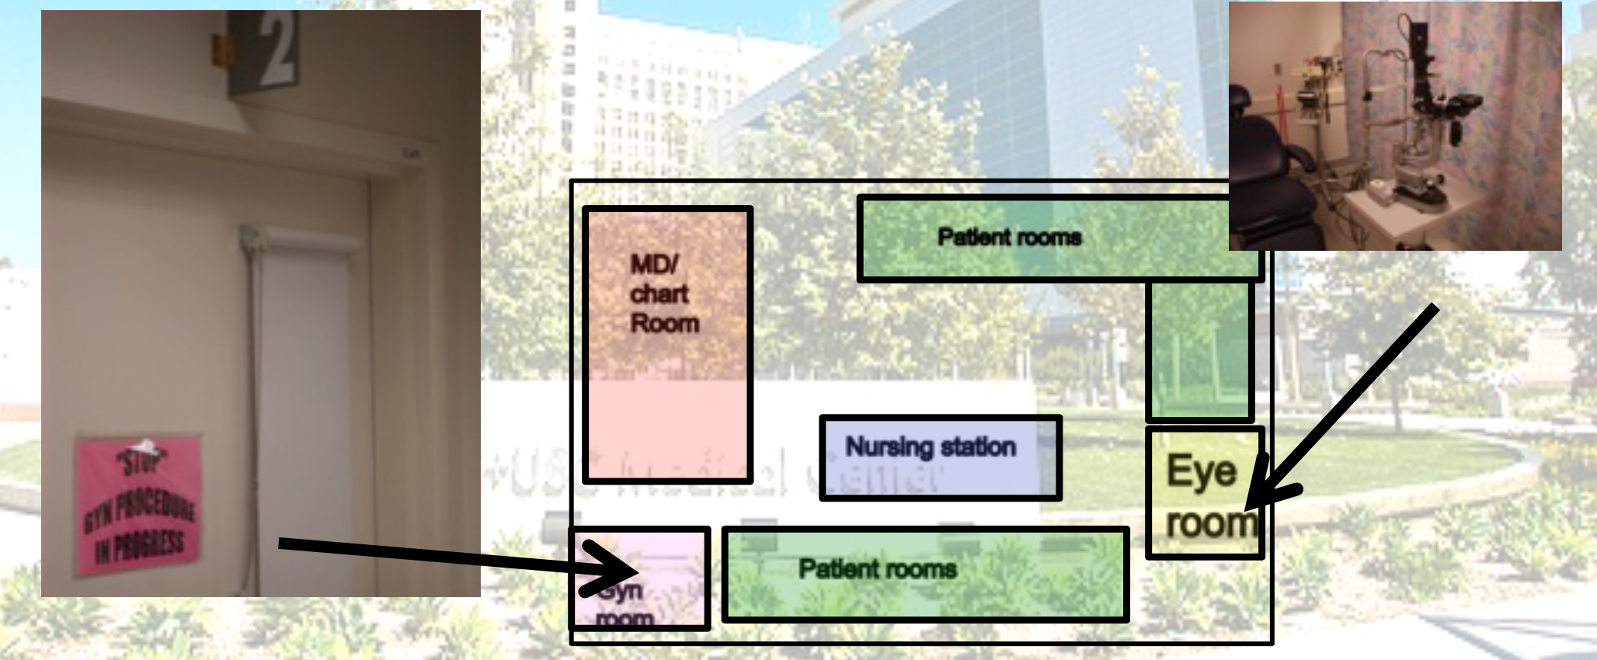
ROOM 2
ROOM 7
Notes:
In West, there are also separate rooms for gynecologic and ocular complaints

Slide 8
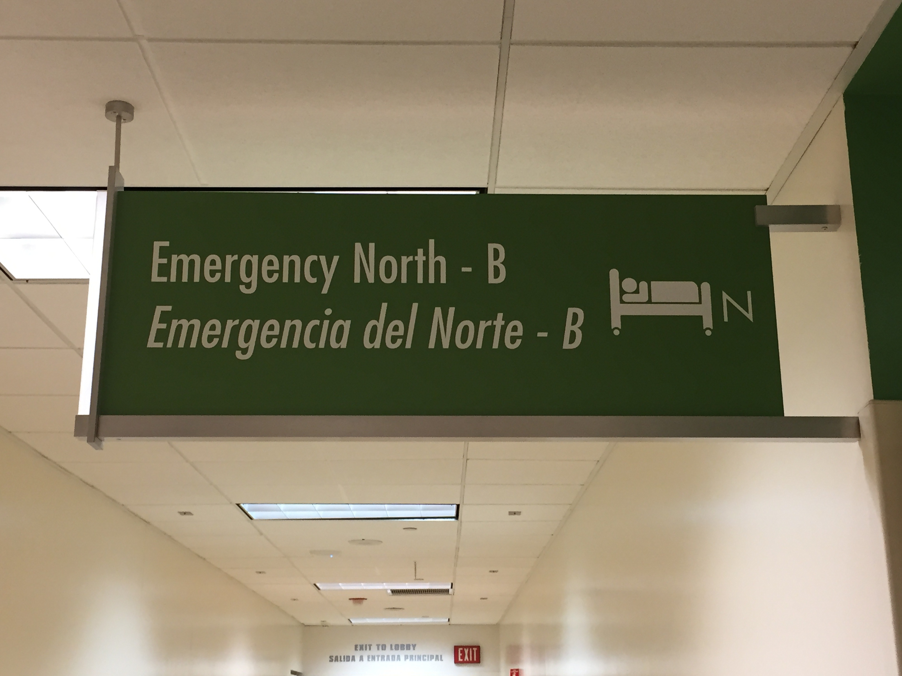
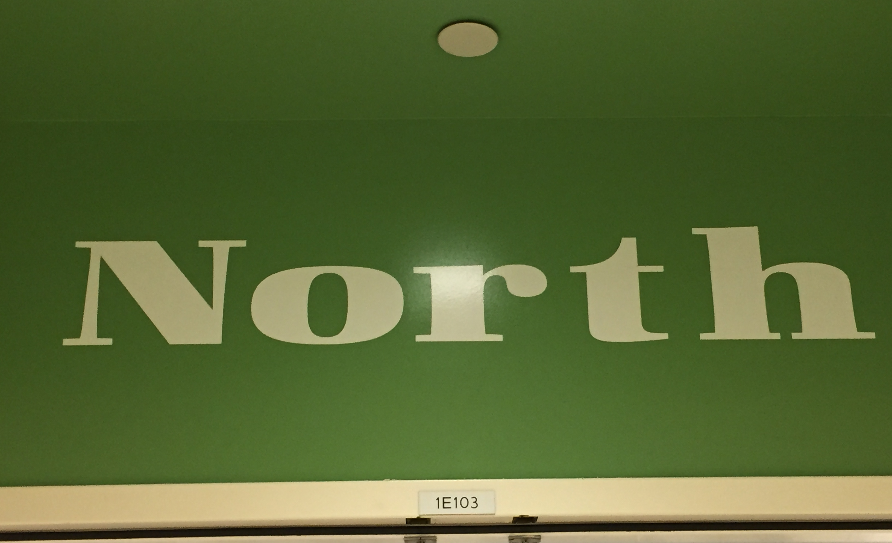
Notes:
North sees the majority of adult undifferentiated medical and surgical patients, such as headache, chest pain and abdominal pain

Slide 9
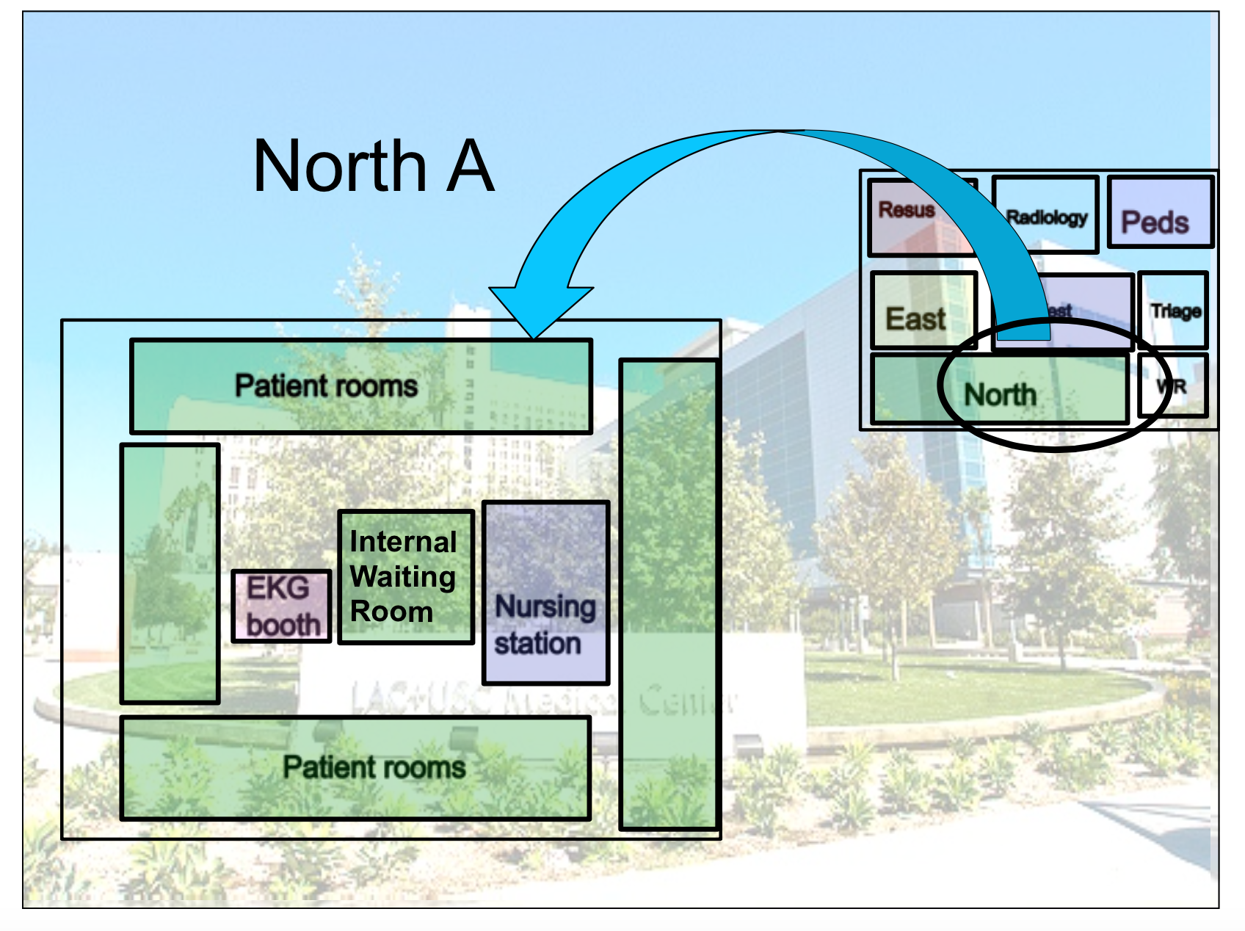
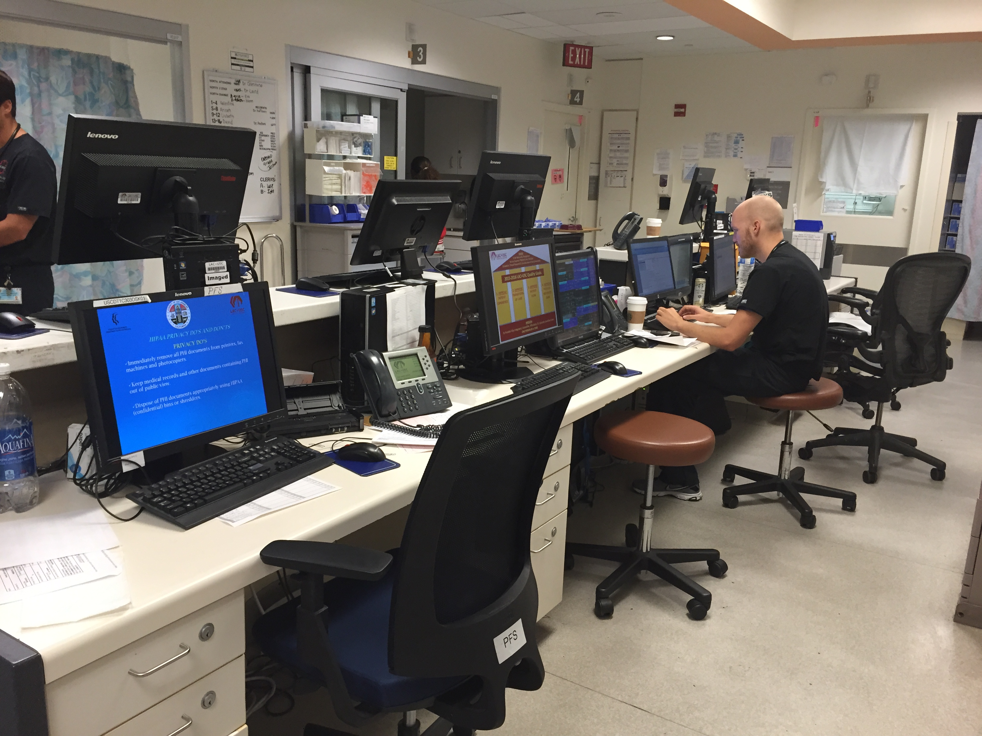
Notes:
North flow is different from West in that certain rooms are designated to the fourth, third, second and first year emergency medicine residents
You will be assigned typically to work with a 4th year resident, however all cases must be presented to the attending before any disposition decisions are made
This is an example of a North workspace, shared by both doctors and nurses

Slide 10
Shifts
Please present all cases to the attending.
When you leave at the end of your shift, all patients who remain in the Department must be formally passed on to a DEM resident so that their care may be continued.
Please do not hesitate to ask a resident or attending any questions you may have, we’re here for you!

Slide 11
Please submit to:
Jessica Osterman, MD from the DEM
- Take a high resolution picture and email it to jlo114@gmail.com
- Can also drop off a COPY in Rm 1011 in the General Hospital
(but keep your originals!)
**Attention Internal Medicine Residents!
- Please also submit a copy to your IM chief
Notes:
This is your signin sheet
It will need to be completed for every shift
For every shift, you will work with 2 Attendings, therefore, you will need 2 signatures
The sign-in sheet must be turned in at the end of your rotation
Please give one copy to Dr. Osterman and if you are an Internal Medicine resident, please ALSO submit a copy to your IM chief

Slide 12
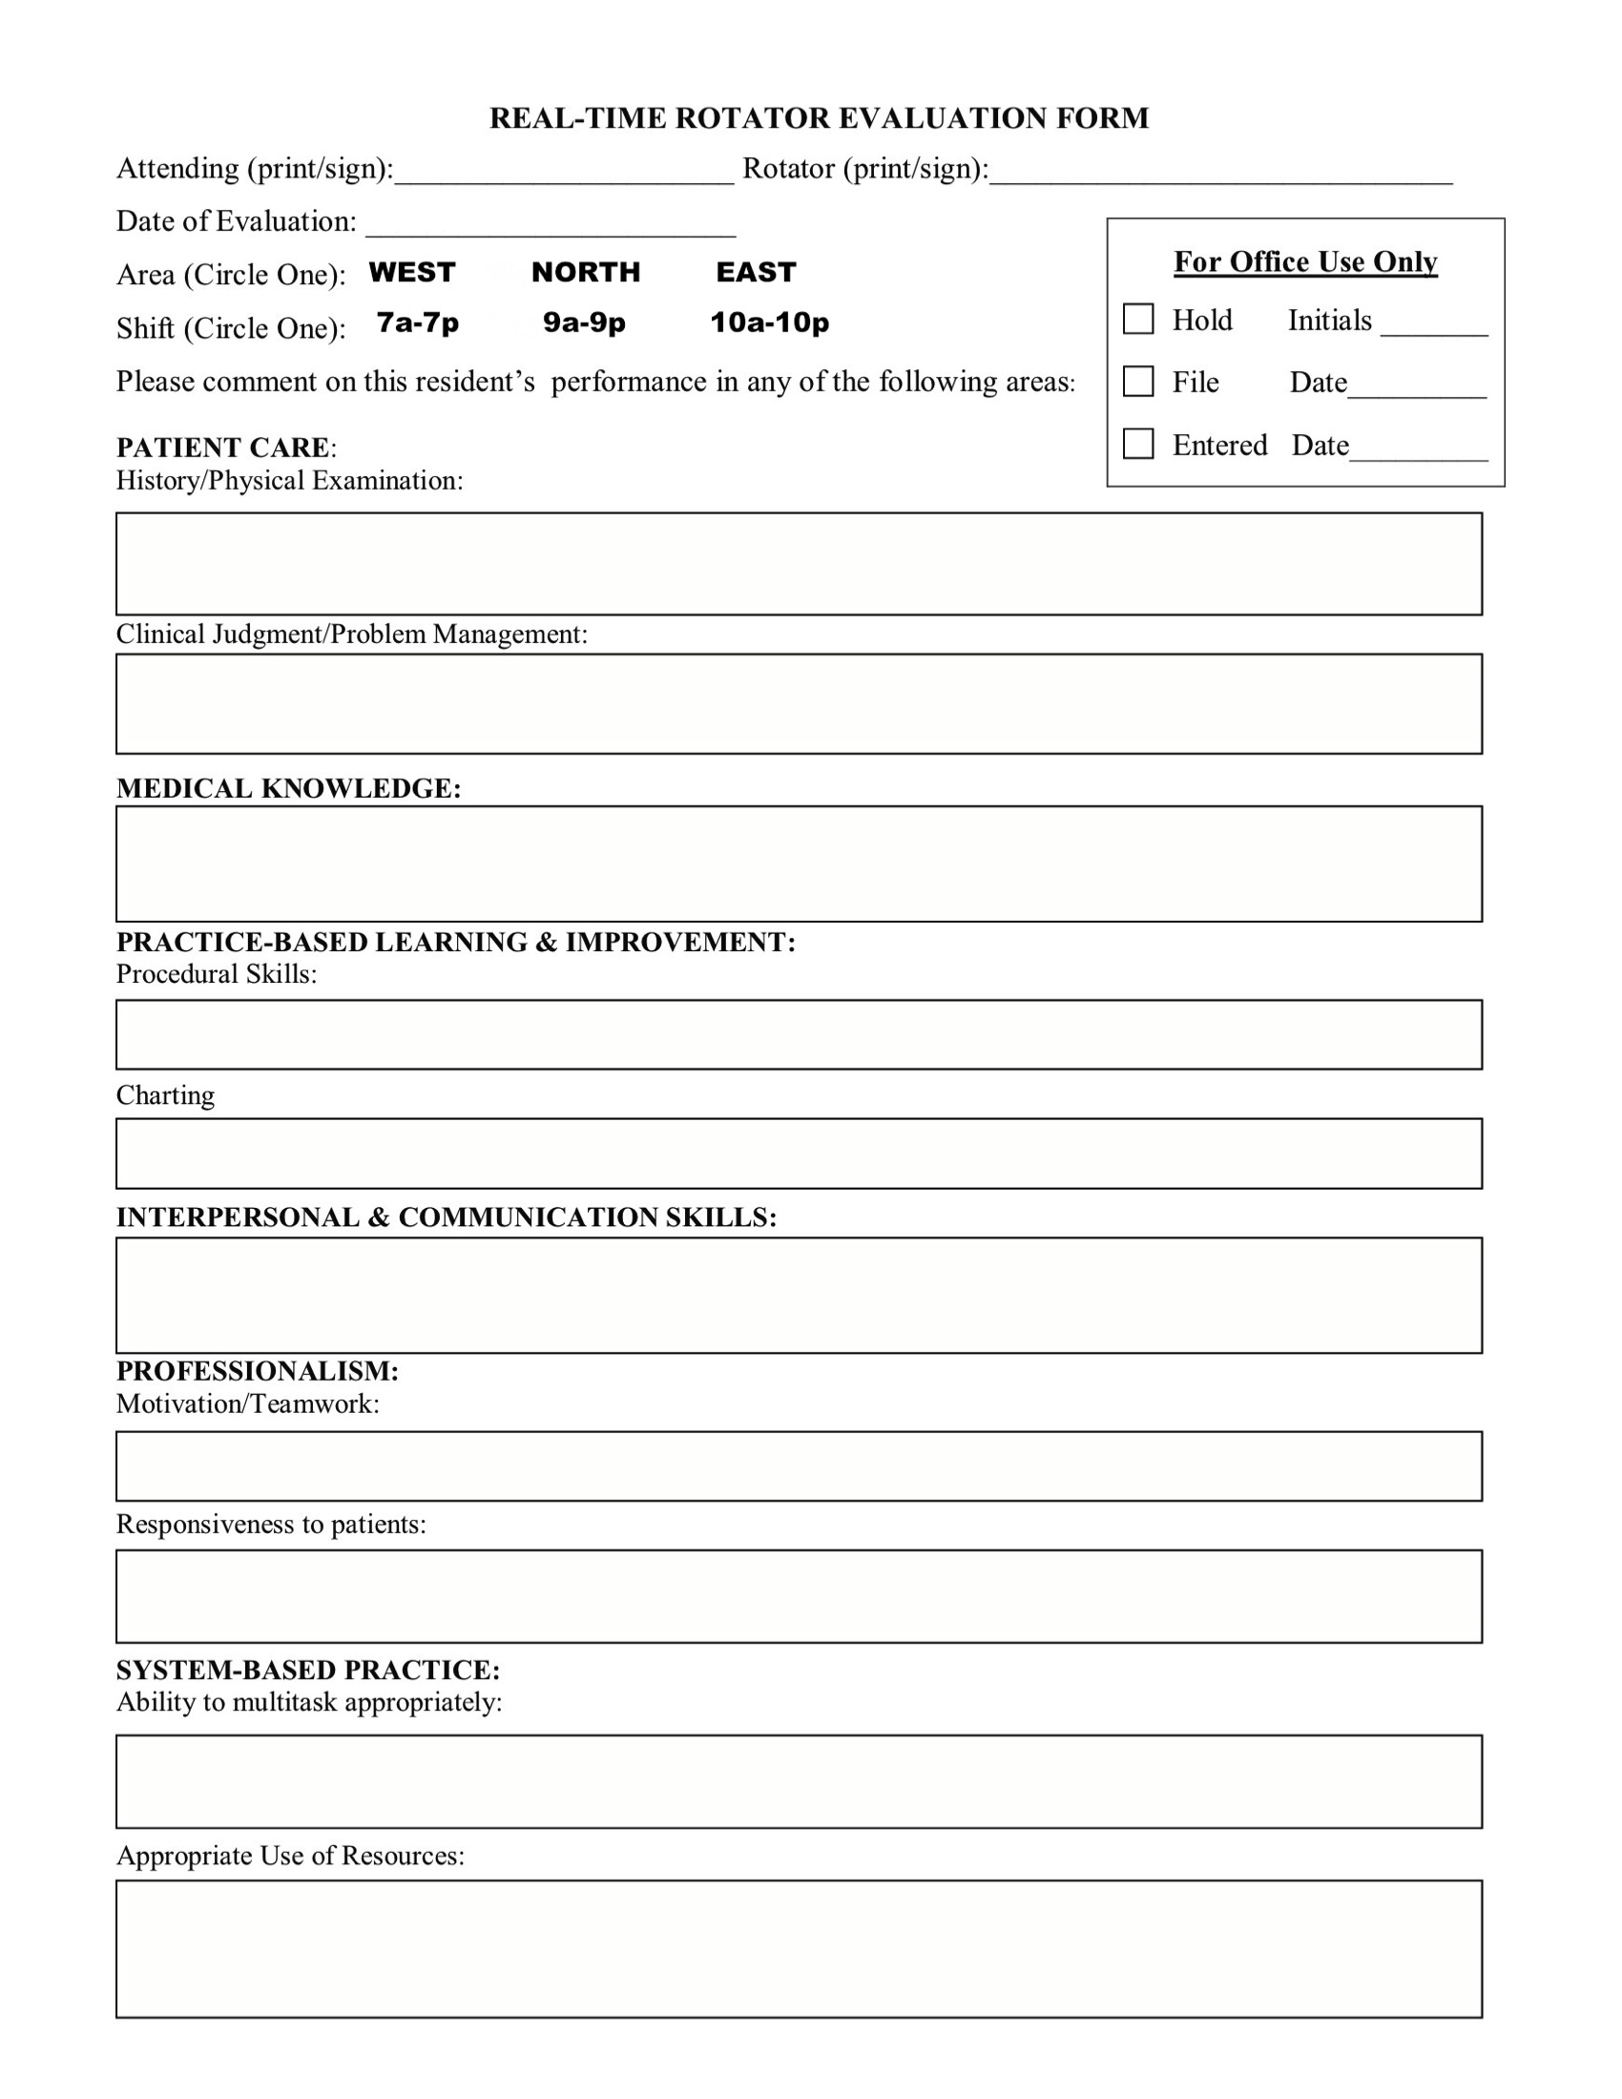
- To be completed by any senior resident or attending you have worked with
- Please email it to jlo114@gmail.com or drop a COPY off in Rm 1011 in the General Hospital (care of Dr. Osterman) and remember, keep your originals!
Notes:
You will also need to complete 1 real time evaluation by the end of the rotation
You may have any senior resident or attending you have worked with fill out the evaluation form
Please submit this to Dr. Osterman as well

Slide 13
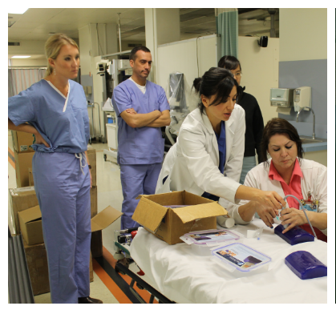
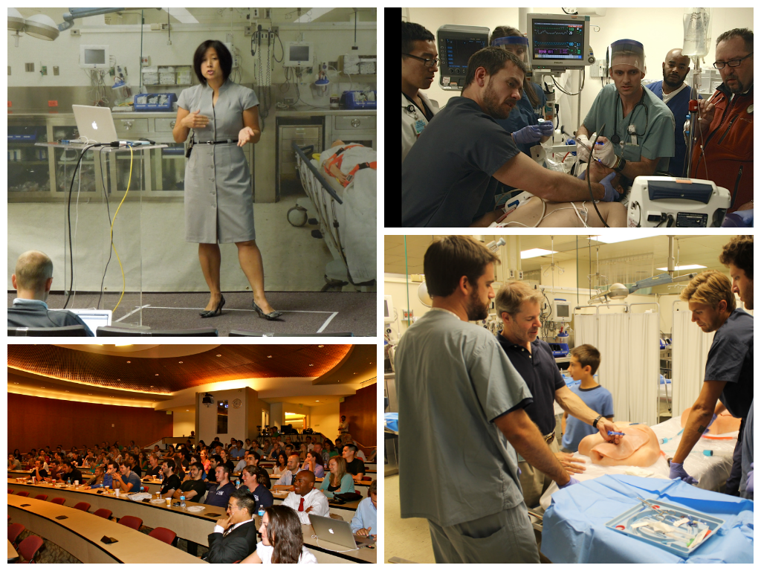
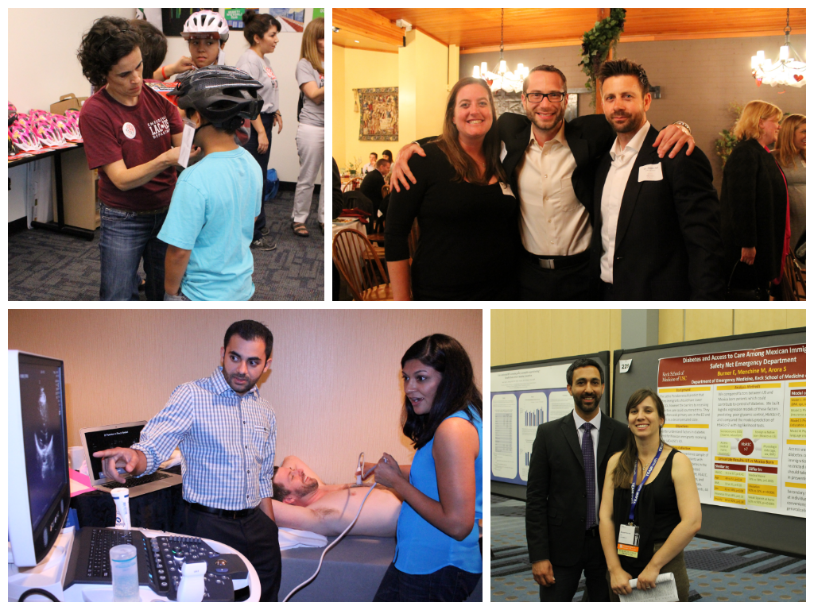
Welcome!
Notes:
Again, welcome to the Department of Emergency Medicine, we’re very excited to work with you!

